Slide 1

Database Technologies - MySQL
A day without new knowledge is a lost day.
Before we start DBT module.
Which module(s) you have completed?
iet
If A and a, B and b, C and c etc. are treated in the same way then it is case-insensitive. MySQL is case-insensitive
In this module we are going to learn SQL, PL/SQL and NoSQL(MongoDB)

Slide 2
Class Room
Session 1

Slide 3
Introduction
If anyone who wants to develop a good application
then he should have the knowledge three major components.
They are . . . . .
Presentation Tier [ UI ]
Application Tier [ Server Application and Client Application ]
Data Tier [ Data Access Object (DAO) / Data Access Layer (DAL) ] { Flat Files | RDBMS | NoSQL }
So as a programmer:
a person should understand and be able to interact with a database is must, so than the data which is collected from the UI is processed and stored permanently. (eg. Any management systems, set top box, washing machine, mobile application etc.).

Slide 4
Introduction
A layer refers to pieces of software that are logically separated, but typically live within the same process and machine.
A tier, instead, refers to pieces of software that live in distinct processes or AppDomains or machines.
A tier refers to physical separation; a layer is about logical separation.

Slide 5
Introduction
Why do we need databases (Use Case)?
We need databases because they organize data in a manner which allows us to store, query, sort, and manipulate data in various ways. Databases allow us to do all this things.
Many companies collects data from different resource (like Weather data, Geographical data, Finance data, Scientific data, Transport data, Cultural data, etc.)

Slide 6
Introduction
4 Important Roles of Database in Industry.
It is needed for data access within the company.
It is needed to maintain strong relationships between data.
This system allows newer(latest) and better updates.
It helps to search data in a better manner.

Slide 7
What is Relation and Relationship?

Slide 8
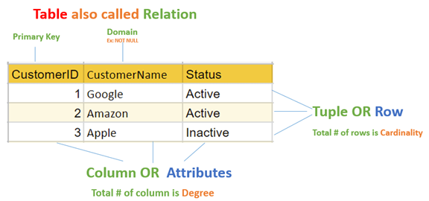
relation and relationship?
Relation (in Relational Algebra "R" stands for relation): In Database, a relation represents a table or an entity than contain attributes.
Relationship: In database, relationship is that how the two entities are connected to each other, i.e. what kind of relationship type they hold between them.
Primary/Foreign key is used to specify this relationship.
Remember:
Foreign Key is also know as
Reference
Referential key.
Note:
Table - The physical instantiation of a relation in the database schema.
Relation - A logical construct that organizes data into rows and columns.

Slide 9
File Systems is the traditional way to keep your data organized.
File System
vs
DBMS

Slide 10
file-oriented system
struct Employee {
int emp_no;
char emp_name[50];
int salary;
} emp[1000];
struct Employee {
int emp_no;
char emp_name[50];
int salary;
};
struct Employee emp[1000];
File Anomalies
c:\employee.txt
c:\employee.txt
c:\employee.txt
c:\employee.txt
c:\employee.txt
1 suraj 4000
2 ramesh 6000
3 rajan 4500
. |
. |
. |
500 sam 3500
. |
. |
. |
1000 amit 2300
1 suraj 4000
2 ramesh 6000
3 rajan 4500
. |
. |
. |
500 sam 3500
. |
. |
1000 amit 2300
. |
. |
. |
2000 jerry 4500
. |
. |
1 suraj 4000
2 ramesh 6000
3 rajan 4500
. |
. |
. |
500 sam 3500
. |
. |
1000 amit 2300
. |
1000 amit 2300
. |
2000 jerry 4500
. |
. |
1 suraj 4000
2 ramesh 6000
3 rajan 4500
. |
. |
. |
sam 500 3500
. |
. |
1000 amit 2300
. |
1000 amit 2300
. |
jerry 2000 4500
. |
. |
1 suraj 4000
2 ramesh 6000
3 rajan 4500
. |
. |
. |
500 sam 3500
. |
. |
. |
. |
. |
1250 neel 4500

Slide 11
Create/Open an existing file
Reading from file
Writing to a file
Closing a file
file-oriented system
File Anomalies
c:\employee.txt
file attributes
file permissions
search empl ID=1
search emp_name
1 suraj 4000
2 ramesh 6000
3 rajan 4500
. |
. |
. |
500 sam 3500
. |
. |
. |
1000 amit 2300
File Name
Type
Location
File permissions
Share permissions
1 suraj 4000
2 ramesh 6000
3 rajan 4500
. |
. |
. |
500 sam 3500
. |
. |
. |
1000 amit 2300
1 suraj 4000
2 ramesh 6000
3 rajan 4500
. |
. |
. |
500 sam 3500
. |
. |
. |
1000 amit 2300

Slide 12
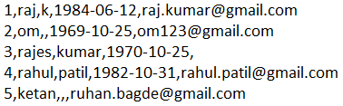
file-oriented system
A flat file database is a database that stores data in a plain text file (e.g. *.txt, *.csv, *.tsv etc. format). Each line of the text file holds one record, with fields separated by delimiters, such as commas or tabs.
1 rajan MG Road Pune MH 34500
2 rahul patil SSG Lane Pune MH 54000
3 suraj raj k Deccan Gymkhana Pune MH 22000
4, S M Kumar, Mg Road Pune MH, 32000
5, S M Kumar, Mg Road, Pune, MH, 32000
The Zen of Python,
Beautiful is better than ugly.
Explicit is better than implicit.
Simple is better than complex.
Complex is better than complicated.
Flat is better than nested.
Sparse is better than dense.
Readability counts.
Special cases aren't special enough to break the rules.
Although practicality beats purity.
Errors should never pass silently.
Unless explicitly silenced.
In the face of ambiguity, refuse the temptation to guess.
There should be one-- and preferably only one --obvious way to do it.
Although that way may not be obvious at first unless you're Dutch.
Now is better than never.
Although never is often better than *right* now.
If the implementation is hard to explain, it's a bad idea.
If the implementation is easy to explain, it may be a good idea.
Namespaces are one honking great idea -- let's do more of those!

Slide 13
advantages of file-oriented system
The biggest advantage of file-based storage is that anyone can understand the system.
Advantage of File-oriented system
Backup: It is possible to take faster and automatic back-up of database stored in files of computer-based systems.
Data retrieval: It is possible to retrieve data stored in files in easy and efficient way.
Editing: It is easy to edit any information stored in computers in form of files.
Remote access: It is possible to access data remote location.
Sharing: The files stored in systems can be shared among multiple users at a same time.

Slide 14
disadvantage of file-oriented system
The biggest disadvantage of file-based storage is as follows.
Disadvantage of File-oriented system
Data redundancy: It is possible that the same information may be duplicated in different files. This leads to data redundancy results in memory wastage. (Suppose a customer having both kind of accounts- saving and current account. In such a situation a customers detail are stored in both the file, saving.txt- file and current.txt- file , which leads to Data Redundancy.)
Data inconsistency: Because of data redundancy, it is possible that data may not be in consistent state. (Suppose customer changed his/her address. There might be a possibility that address is changed in only one file (saving.txt) and other (current.txt) remain unchanged.)
Limited data sharing: Data are scattered in various files and also different files may have different formats (for example: .txt, .csv, .tsv and .xml) and these files may be stored in different folders so, due to this it is difficult to share data among different applications.
Data Isolation: Because data are scattered in various files, and files may be in different formats (for example: .txt, .csv, .tsv and .xml), writing new application programs to retrieve the appropriate data is difficult.
Data security: Data should be secured from unauthorized access, for example a account holder in a bank should not be able to see the account details of another account holder, such kind of security constraints are difficult to apply in file processing systems.

Slide 15

A database application is a computer program whose primary purpose is entering and retrieving information.
What is database?

Slide 16

what is database?
A database is a system to organize, store and retrieve large amounts of data easily, which is stored in one or more data files by one or more users.
Each database is a collection of tables, which are called relations, hence the name "relational database".
Index Page

Slide 17

Relation Schema: A relation schema represents name of the relation with its attributes.
e.g. student (roll_no, name, address, phone and age) is relation schema for STUDENT
DBMS
The database management system (DBMS) is the software that interacts with end users, applications, and the database itself to store and analyze the data.
database: Is the collection of related data which is organized, database can store and retrieve large amount of data easily, which is stored in one or more data files by one or more users, it is called as structured data.
management system: it is a software, designed to define, manipulate, retrieve and manage data in a database.
A database is an organized collection of structured data.

Slide 18
Difference between File System and DBMS
File Management System | Database Management System
File System is easy-to-use system to store data which require less security and constraints. | Database Management System is used when security constraints are high.
Data Redundancy is more in File System. | Data Redundancy is less in Database Management System.
Data Inconsistency is more in File System. | Data Inconsistency is less in Database Management System.
Centralization is hard to get when it comes to File System. | Centralization is achieved in Database Management System.
User locates the physical address of the files to access data in File System. | In Database Management System, user is unaware of physical address where data is stored.
Security is low in File System. | Security is high in Database Management System.
File System stores unstructured data. "unstructured data" may include documents, audio, video, images, and files. | Database Management System stores structured data.

Slide 19



relational database management system?
A RDBMS is a database management system (DBMS) that is based on the relational model introduced by Edgar Frank Codd at IBM in 1970.
RDBMS supports
client/server Technology
Highly Secured
Relationship (PK/FK)
A server is a computer program or device that provides a service to another computer program and its user, also known as the client.
In the client/server programming model, a server program awaits and fulfills requests from client programs, which might be running in the same, or other computers.

Slide 20
object relational database management system?
An object database is a database management system in which information is represented in the form of objects.
PostgreSQL is the most popular pure ORDBMS. Some popular databases including Microsoft SQL Server, Oracle, and IBM DB2 also support objects and can be considered as ORDBMS.

Slide 21
relational model concepts
and
properties of relational table

Slide 22
relational model concepts
Relational model organizes data into one or more tables (or "relations") of columns and rows. Rows are also called records or tuples. Columns are also called attributes.
Tables − In relational model, relations are saved in the form of Tables. A table has rows and columns.
Attribute − Attributes are the properties that define a relation. e.g. (roll_no, name, address, phone and age)
Tuple − A single row of a table, which contains a single record for that relation is called a tuple.
Relation schema − A relation schema describes the relation name (table name) with its attribute (columns) names.
Attribute domain − Every attribute has some pre-defined datatypes, known as attribute domain.
Relation key − Each row has one or more attributes, known as relation key, which can identify the row in the relation (table) uniquely.
e.g. student(roll_no, name, address, phone and age) is relation schema for student relation.

Slide 23
properties of relational table
ID | job | firstName | DoB | salary
1 | manager | Saleel Bagde | yyyy-mm-dd | ●●●●●●
3 | salesman | Sharmin | yyyy-mm-dd | ●●●●●●
4 | accountant | Vrushali | yyyy-mm-dd | ●●●●●●
2 | salesman | Ruhan | yyyy-mm-dd | ●●●●●●
5 | 9500 | manager | yyyy-mm-dd | ●●●●●●
5 | Salesman | Rahul Patil | yyyy-mm-dd | ●●●●●●
Domain refers to all the valid values which a column may contain.
Relational tables have six properties:
Values are atomic.
Column values are of the same kind. (Attribute Domain: Every attribute has some pre-defined datatypes, known as attribute domain.)
Each row is unique.
The sequence of columns is insignificant – (unimportant).
The sequence of rows is insignificant – (unimportant).
Each attribute/column must have a unique name.

Slide 24

What is data?

Slide 25

what is data?
Data is any facts that can be stored and that can be processed by a computer.
Data can be in the form of Text or Multimedia
e.g.
number, characters, or symbol
images, audio, video, or signal

Slide 26
ACID

Slide 27
ACID properties of transactions
Atomicity. In a transaction involving two or more separate pieces of information, either all of the pieces are committed or none are.
For example, in an application that transfers funds from one account to another, the atomicity property ensures that, if a debit is made successfully from one account, the corresponding credit is made to the other account.
Consistency. A transaction either creates a new and valid state of data, or, if any failure occurs, returns all data to its state before the transaction was started.
For example, in an application that transfers funds from one account to another, the consistency property ensures that the total value of funds in both the accounts is the same at the start and end of each transaction.
Isolation. A transaction in process and not yet committed must remain isolated from any other transaction.
For example, in an application that transfers funds from one account to another, the isolation property ensures that another transaction sees the transferred funds in one account or the other, but not in both, nor in neither.
Durability. Committed data is saved by the system such that, even in the event of a failure and system restart, the data is available in its correct state.
For example, in an application that transfers funds from one account to another, the durability property ensures that the changes made to each account will not be reversed.

Slide 28
What is Entity Relationship Diagram?

Slide 29
Entity Relationship Diagram (ER Diagram)
Use E-R model to get a high-level graphical view to describe the "ENTITIES" and their "RELATIONSHIP"
The basic constructs/components of ER Model are
Entity, Attributes and Relationships.

Slide 30
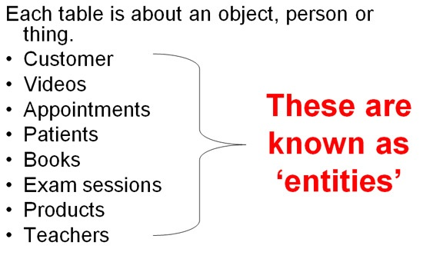
An entity can be a real-world object.
What is Entity?

Slide 31
entity
In relation to a database , an entity is a
Person(student, teacher, employee, department, …)
Place(classroom, building, …) --a particular position or area
Thing(computer, lab equipment, …) --an object that is not named
Concept(course, batch, student’s attendance, …) -- an idea,
about which data can be stored. All these entities have some attributes or properties that give them their identity.
Every entity has its own characteristics.

Slide 32
What is Entity Type?

Slide 33
entity type
The entities that have the common attributes is called an entity type.
Each entity type in the database is described by a name and a list of attributes.
e.g. an entity Person is an entity type that has Age, Name and Address attributes.
Eg.
Entity TYPE Entity
Person (Age, Name, Address ,. . .) 17 , Sharmin, Paud Road, …

Slide 34

When you are designing attributes for your entities, you will sometimes find that an attribute does not have a value. For example, you might want an attribute for a person's middle name, but you can't require a value because some people have no middle name. For these, you can define the attribute so that it can contain null values.
What is an Attribute?
Attributes are the properties that define a relation.
e.g. student(ID, firstName, middleName, lastName, city)
Entity
In some cases, you might not want a specific attribute to contain a null value, but you don't want to require that the user or program always provide a value. In this case, a default value might be appropriate. A default value is a value that applies to an attribute if no other valid value is available.
Attribute

Slide 35
attributes
A table has rows and columns
In RDBMS, a table organizes data in rows and columns. The COLUMNS are known as ATTRIBUTES / FIELDS whereas the ROWS are known as RECORDS / TUPLE.
In Relation: EMP
Attributes
ID | EmployeeName | Job | Hiredate | Salary
1 | KING | PRESIDENT | 2017-02-15 | 5000
… | … | … | … | …
… | … | … | … | …
… | … | … | … | …
Rows

Slide 36
attributes
In Entity Relationship(ER) Model attributes can be classified into the following types.
Simple/Atomic and Composite Attribute
Single Valued and Multi Valued attribute
Stored and Derived Attributes
Complex Attribute

Slide 37
attributes
Simple / Atomic Attribute --VS-- Composite Attribute
(Can’t be divided further) (Can be divided further)
Single Value Attribute --VS-- Multi Valued Attribute
(Only One value) (Multiple values)
Stored Attribute --VS-- Derived Attribute
(Only One value) (Virtual)
Complex Attribute
(Composite & Multivalued)
Atomic Attribute: An attribute that cannot be divided into smaller independent attribute is known as atomic attribute.
e.g. ID’s, age, gender, zip, marital status cannot further divide.
Single Value Attribute: An attribute that has only single value is known as single valued attribute.
e.g. manufactured part can have only one serial number, voter card, blood group, price, quantity, branch can have only one value.
Stored Attribute: The stored attribute are such attributes which are already stored in the database and from which the value of another attribute is derived.
e.g. (HRA, DA…) can be derive from salary, age can be derived from DoB, total marks or average marks of a student can be derived from marks.

Slide 38
Composite VS Multi Valued Attribute

Slide 39

composite / multi valued attributes
Composite Attribute
Person Entity
Name attribute: ( firstName, middleName, and lastName )
PhoneNumber attribute: ( countryCode, cityCode, and phoneNumber )
Multi Valued Attribute
Person Entity
Hobbies attribute: [ reading, hiking, hockey, skiing, photography, . . . ]
SpokenLanguages attribute: [ Hindi, Marathi, Gujarati, English, . . . ]
Degrees attribute: [ 10th , 12th, BE, ME, PhD, . . . ]
emailID attribute: [ saleel@gmail.com, salil@yahoomail.com, . . . ]

Slide 40
What is an Prime, Non-Prime Attribute?

Slide 41
attributes
Prime attribute (Entity integrity)
An attribute, which is a part of the prime-key (candidate key), is known as a prime attribute.
Non-prime attribute
An attribute, which is not a part of the prime-key (candidate key), is said to be a non-prime attribute.

Slide 42
Entity Relationship Diagram Symbols

Slide 43
erdplus.com
www.draw.io
entity relationship diagram symbols
Attribute
Composite Attribute
Key Attribute
Strong Entity
Weak Entity
Derived Attribute
Weak Relationship
Relationship
Multivalued Attribute

Slide 44
strong and weak entity
An entity may participate in a relation either totally or partially.
Strong Entity: A strong entity is not dependent on any other entity in the schema. A strong entity will always have a primary key. Strong entities are represented by a single rectangle.
Weak Entity: A weak entity is dependent on a strong entity to ensure its existence. Unlike a strong entity, a weak entity does not have any primary key. A weak entity is represented by a double rectangle. The relation between one strong and one weak entity is represented by a double diamond. This relationship is also known as identifying relationship.

Slide 45
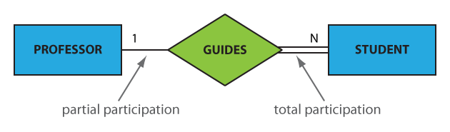
participation constraints
An entity may participate in a relation either totally or partially.
Total participation means that every entity is involved in the relationship, e.g., each student must be guided by a professor (there are no students who are not guided by any professor. This kind of relation is represented as a double line.
Partial participation means that not all entities are involved in the relationship, e.g., not every professor guides a student (there are professors who don’t). A partial participation is represented by a single line.

Slide 46
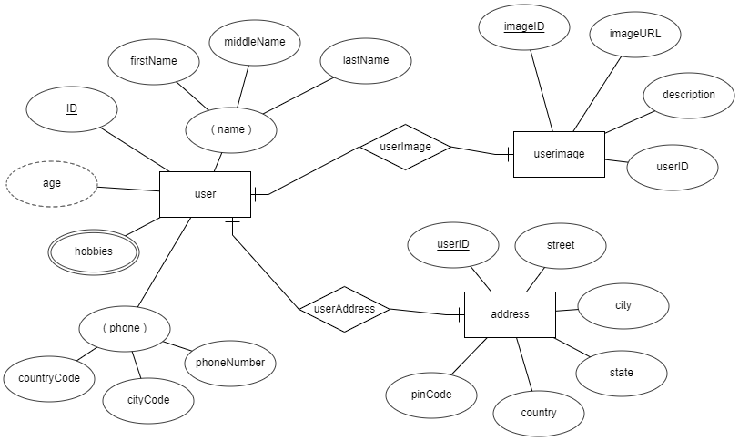
entity relationship diagram
DoB

Slide 47
What is a degree, cardinality, domain and union in database?

Slide 48
What is a degree, cardinality, domain and union in database?
Degree d(R) / Arity: Total number of attributes/columns present in a relation/table is called degree of the relation and is denoted by d(R).
Cardinality |R|: Total number of tuples/rows present in a relation/table, is called cardinality of a relation and is denoted by |R|.
Domain: Total range of accepted values for an attribute of the relation is called the domain of the attribute. (Data Type)
Union Compatibility: Two relations R and S are set to be Union Compatible to each other if and only if:
They have the same degree d(R).
Domains of the respective attributes should also be same.

Slide 49
What is domain constraint and types of data integrity constraints?

Slide 50
Data integrity refers to the correctness and completeness of data.
A domain constraint and types of data integrity constraints
Domain Constraint = data type + Constraints (not null/unique/primary key/foreign key/check/default)
e.g. custID INT, constraint pk_custid PRIMARY KEY(custID)
Three types of integrity constraints: entity integrity, referential integrity and domain integrity:
Entity integrity: Entity Integrity Constraint is used to ensure the uniqueness of each record the table. There are primarily two types of integrity constraints that help us in ensuring the uniqueness of each row, namely, UNIQUE constraint and PRIMARY KEY constraint.
Referential integrity: Referential Integrity Constraint ensures that there always exists a valid relationship between two tables. This makes sure that if a foreign key exists in a table relationship then it should always reference a corresponding value in the second table or it should be null.
Domain integrity: A domain is a set of values of the same type. For example, we can specify if a particular column can hold null values or not, if the values have to be unique or not, the data type or size of values that can be entered in the column, the default values for the column, etc..

Slide 51
types of Keys?

Slide 52
Keys are used to establish relationships between tables and also to uniquely identify any record in the table.
types of Keys?
r = Employee(EmployeeID, FullName, job, salary, PAN, DateOfBirth, emailID, deptno)
Candidate Key: are individual columns in a table that qualifies for uniqueness of all the rows. Here in Employee table EmployeeID, PAN or emailID are Candidate keys.
Primary Key: is the columns you choose to maintain uniqueness in a table. Here in Employee table you can choose either EmployeeID, PAN or emailID columns, EmployeeID is preferable choice.
Alternate Key: Candidate column other the primary key column, like if EmployeeID is primary key then , PAN or emailID columns would be the Alternate key.
Super Key: If you add any other column to a primary key then it become a super key, like EmployeeID + FullName is a Super Key.
Composite Key: If a table do not have any single column that qualifies for a Candidate key, then you have to select 2 or more columns to make a row unique. Like if there is no EmployeeID, PAN or emailID columns, then you can make FullName + DateOfBirth as Composite key. But still there can be a narrow chance of duplicate row.

Slide 53
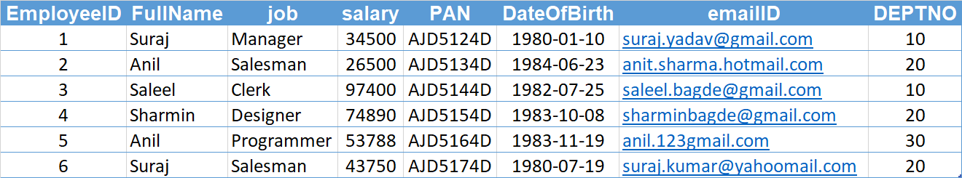
Candidate Key
Primary Key
Composite Key
Alternate Key

Slide 54
Common relationships

Slide 55

relationships - binary
The three most common relationships in ER models are Binary, Unary, and Ternary
A binary relationship is when two entities participate and is the most common relationship.

Slide 56
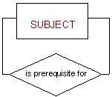
relationships - unary
The three most common relationships in ER models are Binary, Unary, and Ternary
A unary relationship is when both participants in the relationship are the same entity.

Slide 57
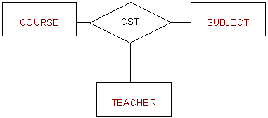
relationships - ternary
The three most common relationships in ER models are Binary, Unary, and Ternary
A ternary relationship is when three entities participate in the relationship.

Slide 58
Degrees of relationship
The degree of relationship can be defined as the number of occurrences in one entity that is associated with the number of occurrences in another entity.

Slide 59

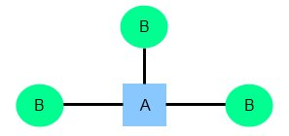
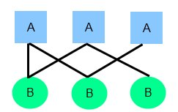
relationships
There are three degrees of relationship
one-to-one (1:1)
one-to-many (1:M)
many-to-many (M:N)

Slide 60
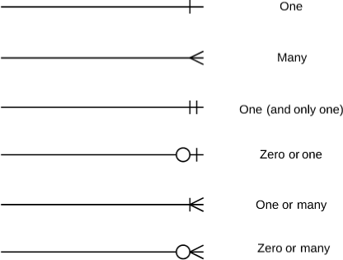
relationships

Slide 61
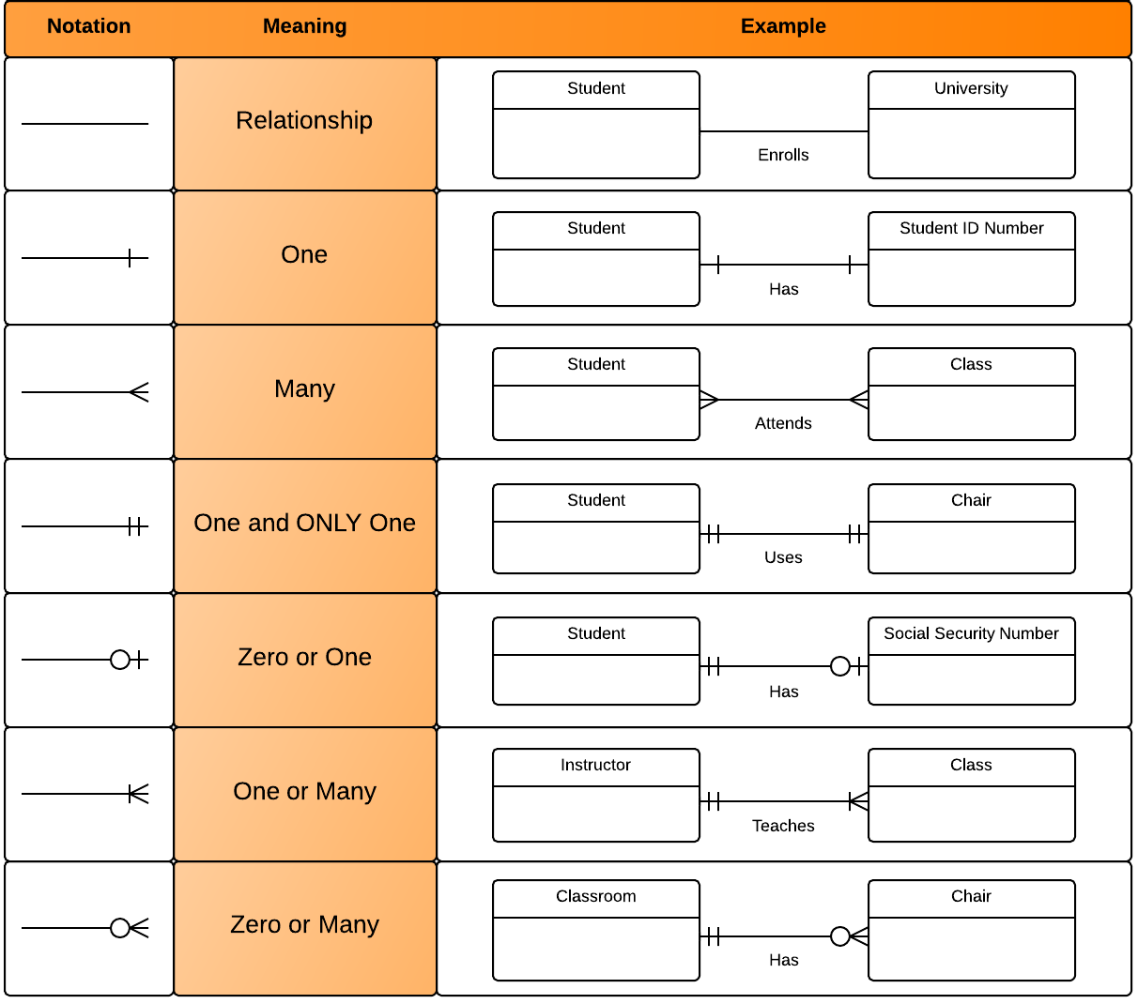
relationships

Slide 62
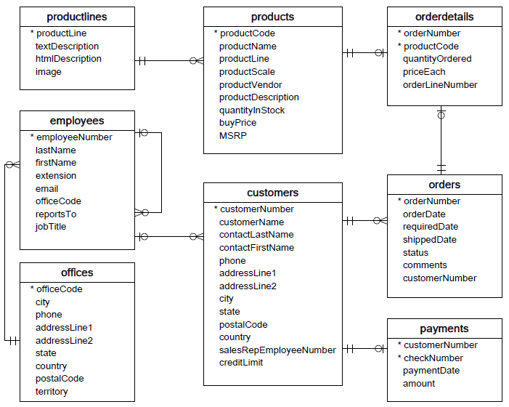

Slide 63
one-to-one relationship

Slide 64
one-to-one relationship
A one-to-one relationship between two tables means that a row in one table can only relate to zero/one row in the table on the other side of their relationship. This is the least common database relationship.
A one-to-one relationship is a type of cardinality that refers to the relationship between two entities R and S in which one element of entity R may only be linked to zero/one element of entity S, and vice versa.
Country
Capital
Country
Capital
Country
one-to-one relationship
Capital
Country
Capital
=
Country
Capital
Country
Capital

Slide 65
one-to-one relationship
A one-to-one relationship between two tables means that a row in one table can only relate to zero/one row in the table on the other side of their relationship. This is the least common database relationship.
A one-to-one relationship is a type of cardinality that refers to the relationship between two entities R and S in which one element of entity R may only be linked to zero/one element of entity S, and vice versa.
Person-1
Passport-1
Person-1
Passport-1
Person-2
Passport-1
Person-2
Passport-1
one-to-one relationship
=
Person-3
Passport-1
Person-4
Passport-1
Person-4

Slide 66
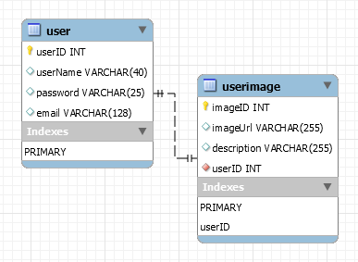
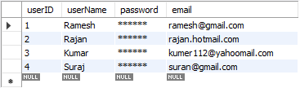
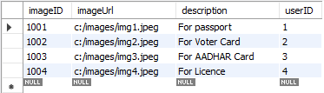
how to create one-to-one relationship
CREATE TABLE user (
userID INT PRIMARY KEY,
userName VARCHAR(40),
password VARCHAR(25),
email VARCHAR(128)
) ;
CREATE TABLE userImage (
imageID INT PRIMARY KEY,
imageUrl VARCHAR(255),
description VARCHAR(255),
userID INT NOT NULL UNIQUE,
FOREIGN KEY(UserID) REFERENCES user(userID)
) ;

Slide 67
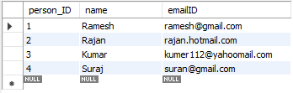

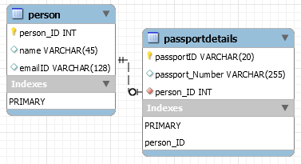
how to create one-to-one relationship
CREATE TABLE person (
person_ID INT PRIMARY KEY ,
name VARCHAR(45),
emailID VARCHAR(128)
);
CREATE TABLE passportDetails (
passportID VARCHAR(20) PRIMARY KEY,
passport_Number VARCHAR(255),
person_ID INT UNIQUE,
FOREIGN KEY(person_ID) REFERENCES person(person_ID)
);

Slide 68
one-to-many relationship

Slide 69
one-to-many relationship
A one-to-many relationship between two tables means that a row in one table can have zero or more row in the table on the other side of their relationship.
a one-to-many relationship is a type of cardinality that refers to the relationship between two entities R and S in which an element of R may be linked to many elements of S, but a member of S is linked to only one element of R.
Customer-1
Order-1
Customer-1
Order-1
Customer-2
Order-1
Customer-2
Order-1
one-to-many relationship
Customer-3
Order-2
=
Customer-2
Order-2
Customer-4
Order-1
Customer-3
Order-1
Customer-5
Order-2
Customer-3
Order-2
Order-3
Customer-3
Order-3
Order-1
Customer-4
Order-1

Slide 70
one-to-many relationship
A one-to-many relationship between two tables means that a row in one table can have one or more row in the table on the other side of their relationship.
a one-to-many relationship is a type of cardinality that refers to the relationship between two entities R and S in which an element of R may be linked to many elements of S, but a member of S is linked to only one element of R.
Invoice-1
Invoice_Item-1
Invoice-1
Invoice_Item-1
Invoice-2
Invoice_Item-1
Invoice-2
Invoice_Item-1
one-to-many relationship
Invoice-3
Invoice_Item-2
=
Invoice-2
Invoice_Item-2
Invoice-4
Invoice_Item-1
Invoice-3
Invoice_Item-1
Invoice_Item-2
Invoice-3
Invoice_Item-2
Invoice_Item-2
Invoice-3
Invoice_Item-3
Invoice_Item-1
Invoice-4
Invoice_Item-1

Slide 71
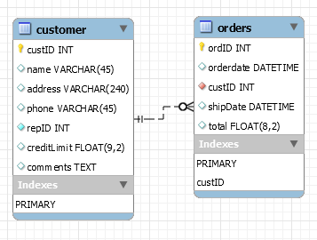
how to create one-to-many relationship
CREATE TABLE customer (
custID INT PRIMARY KEY,
name VARCHAR(45),
address VARCHAR(240),
phone VARCHAR(45),
repID INT NOT NULL,
creditLimit FLOAT(9,2),
comments TEXT,
constraint custid_zero CHECK(custID > 0)
);
CREATE TABLE orders (
ordID INT PRIMARY KEY,
orderdate DATETIME,
custID INT NOT NULL,
shipDate DATETIME,
total FLOAT(8,2),
FOREIGN KEY(custID) REFERENCES customer(custID),
constraint total_greater_zero CHECK(total >= 0)
);

Slide 72
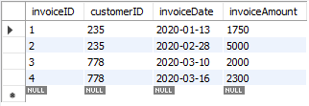
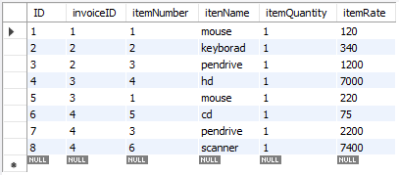
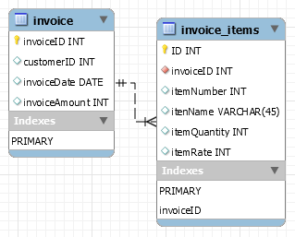
how to create one-to-many relationship
CREATE TABLE invoice (
invoiceID INT PRIMARY KEY,
customerID INT,
invoiceDate DATE,
invoiceAmount INT
);
CREATE TABLE invoice_items (
ID INT PRIMARY KEY,
invoiceID INT NOT NULL,
itemNumber INT,
itenName VARCHAR(45),
itemQuantity INT,
itemRate INT,
FOREIGN KEY(invoiceID) REFERENCES invoice(invoiceID)
);

Slide 73
many-to-one relationship

Slide 74
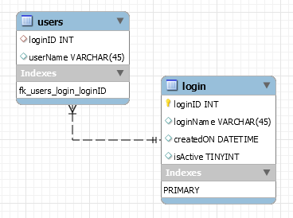
many-to-one relationship
CREATE TABLE users (
loginID INT,
userName VARCHAR(45),
constraint fk_users_login_loginID FOREIGN KEY(loginID) REFERENCES login(loginID)
);
CREATE TABLE login (
loginID INT,
loginName VARCHAR(45),
createdON DATETIME,
isActive TINYINT,
PRIMARY KEY(loginID)
);

Slide 75
many-to-many relationship

Slide 76
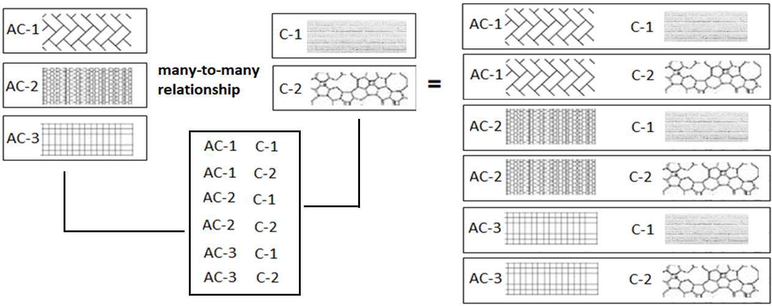
many-to-many relationship
A many-to-many relationship is a type of cardinality that refers to the relationship between two entities R and S in which R may contain a parent instance for which there are many children in S and vice versa.
=
=

Slide 77
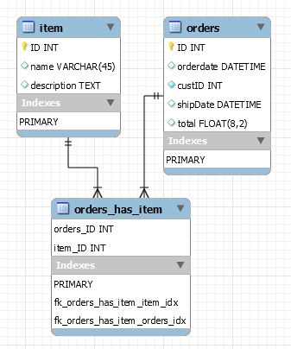
how to create many-to-many relationship
CREATE TABLE item (
item_ID INT PRIMARY KEY,
name VARCHAR(45),
description TEXT
);
CREATE TABLE orders (
orders_ID INT PRIMARY KEY,
orderdate DATETIME,
custID INT NOT NULL,
shipDate DATETIME,
total FLOAT(8,2),
constraint total_greater_zero CHECK(total >= 0)
);
CREATE TABLE orders_has_item (
orders_ID INT NOT NULL,
item_ID INT NOT NULL,
PRIMARY KEY(orders_ID, item_ID),
constraint fk_orders_has_item_orders FOREIGN KEY(orders_ID)
REFERENCES orders(ID),
constraint fk_orders_has_item_item1 FOREIGN KEY(item_ID)
REFERENCES item(ID)
);

Slide 78
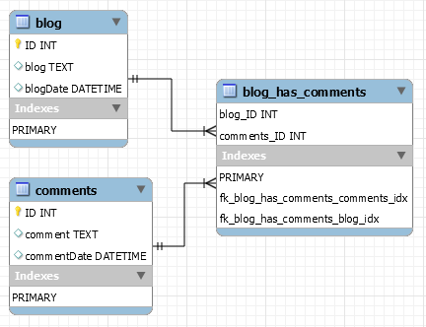
how to create many-to-many relationship
CREATE TABLE blog (
ID INT PRIMARY KEY,
blog TEXT,
blogDate DATETIME
);
CREATE TABLE comments (
ID INT PRIMARY KEY,
comment TEXT,
commentDate DATETIME
);
CREATE TABLE blog_has_comments (
blog_ID INT,
comments_ID INT,
PRIMARY KEY(blog_ID, comments_ID),
constraint fk_blog_has_comments_blog FOREIGN KEY(blog_ID) REFERENCES blog(ID),
constraint fk_blog_has_comments_comments FOREIGN KEY(comments_ID) REFERENCES comments(ID)
);

Slide 79

MySQL
MySQL is the most popular Open Source
Relational Database Management System.
MySQL was created by a Swedish company - MySQL AB that was founded in 1995. It was acquired by Sun Microsystems in 2008; Sun was in turn acquired by Oracle Corporation in 2010.
When you use MySQL, you’re actually using at least two programmes. One program is the MySQL server (mysqld.exe) and other program is MySQL client program (mysql.exe) that connects to the database server.

Slide 80
What is SQL?

Slide 81

what is sql?
Remember:
EXPLICIT or IMPLICIT commit will commit the data.
SQL (Structured Query Language) is a database language designed and developed for managing data in relational database management systems (RDBMS). SQL is common language for all Relational Databases.

Slide 82
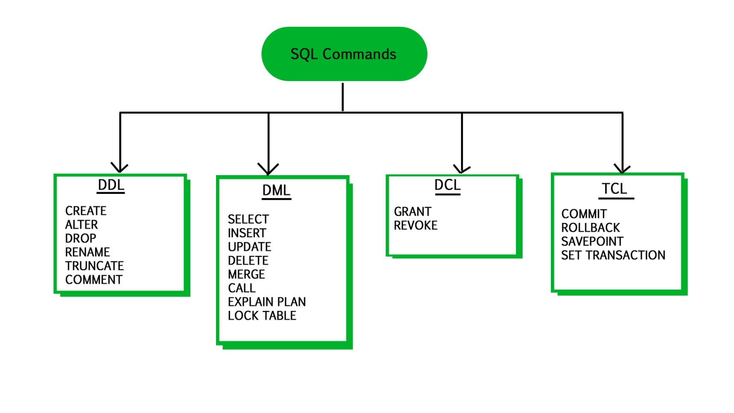
what is sql?
Remember:
An EXPLICIT commit happens when we execute an SQL "COMMIT" command.
An IMPLICIT commits occur without running a "COMMIT" command.
Remember:
A NULL value is not treated as a blank or 0. Null or NULL is a special marker used in Structured Query Language to indicate that a data value does not exist in the database.
Degree d(R): Total no. of attributes/columns present in a relation/table is called degree of the relation and is denoted by d(R).
Cardinality |R|: Total no. of tuples present in a relation or Rows present in a table, is called cardinality of a relation and is denoted by |R|.

Slide 83
comments in mysql
From a # character to the end of the line.
From a -- sequence to the end of the line.
From a /* sequence to the following */ sequence.
Reconnect to the server | \r
Execute a system shell command | \!
Exit mysql | \q

Slide 84
Login to MySQL

Slide 85
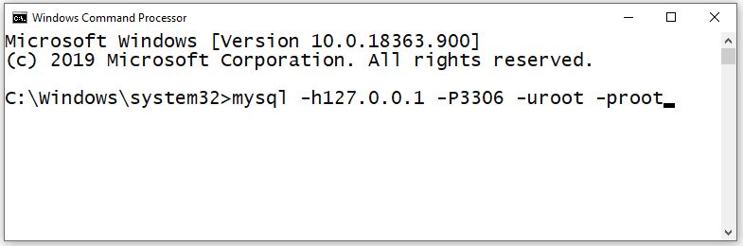
login
Default port for MySQL Server: 3306
C:\> mysql -hlocalhost -P3307 -uroot -p
C:\> mysql -h127.0.0.1 -P3307 -uroot -p [database_name]
C:\> mysql -h192.168.100.14 -P3307 -uroot -psaleel [database_name]
C:\> mysql --host localhost --port 3306 --user root --password=ROOT [database_name]
C:\> mysql --host=localhost --port=3306 --user=root --password=ROOT [database_name]

Slide 86
Before MySQL version 5.5, MyISAM is the default storage engine.
From version 5.5, MySQL uses InnoDB as the default storage engine.
STORAGE ENGINES
A storage engine is a software module that a database management system uses to create, read, update data from a database. There are two types of storage engines in MySQL: transactional and non-transactional.
Storage Engine | File on disk
MEMORY | Data is not stores on the disk
InnoDB | .idb (data and index)
MyISAM | MYD (data), .MYI (index)
CSV | .CSV (data), CSM (metadata)

Slide 87
SHOW ENGINES Syntax
For MySQL 5.5 and later, the default storage engine is InnoDB. The default storage engine for MySQL prior to version 5.5 was MyISAM.
SHOW [STORAGE] ENGINES
SHOW ENGINES displays status information about the server's storage engines. This is particularly useful for checking whether a storage engine is supported, or to see what the default engine is.
INFORMATION_SCHEMA.ENGINES
show engines;
show STORAGE engines;
INFORMATION_SCHEMA provides access to database metadata, information about the MySQL server such as the name of a database or table, the data type of a column, or access privileges.

Slide 88
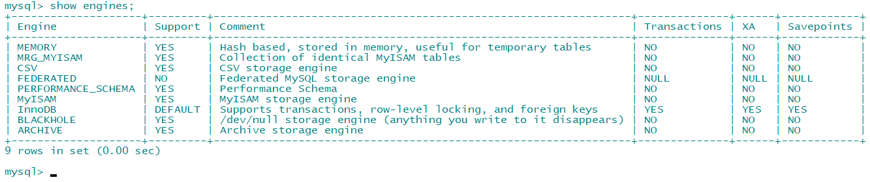
ENGINES
show engines;
show STORAGE engines;
SET DEFAULT_STORAGE_ENGINE = MyISAM;

Slide 89
ENGINES
MEMORY tables are visible to another client, but TEMPORARY tables are not visible to another client.
InnoDB is the most widely used storage engine with transaction support. It is the only engine which provides foreign key referential integrity constraint. Oracle recommends using InnoDB for tables except for specialized use cases.
MyISAM is the original storage engine. It is a fast storage engine. It does not support transactions. MyISAM provides table-level locking. It is used mostly in Web and data warehousing.
Memory storage engine creates tables in memory. It is the fastest engine. It provides table-level locking. It does not support transactions. Memory storage engine is ideal for creating temporary tables or quick lookups. The data is lost when the database is re-started.
CSV stores data in CSV files. It provides great flexibility because data in this format is easily integrated into other applications.

Slide 90
ENGINES
MEMORY tables are visible to another client, but
TEMPORARY tables are not visible to another client.
In the case of InnoDB, it is used to store the tables in tablespace whereas, in the case of MyISAM, it stores each MyISAM table in a separate file.
In my.ini do this changes.
[mysqld]
innodb_file_per_table = 1
Tablespace: A data file that can hold data for one or more InnoDB tables and associated indexes.
System tablespace
File per tablespace
General tablespace
Note:- By default, InnoDB contains only one tablespace called the System tablespace whose identifier is 0

Slide 91
SHOW DATABASES

Slide 92
SHOW DATABASES Syntax
SHOW {DATABASES | SCHEMAS} [LIKE 'pattern' | WHERE expr]
SHOW SCHEMAS is a synonym for SHOW DATABASES.
SHOW DATABASES;
SHOW SCHEMAS;
SHOW DATABASES LIKE 'U%';
SHOW SCHEMAS LIKE 'U%';
NULL means “no database is selected”. Issue the USE dbName command to select the database.

Slide 93
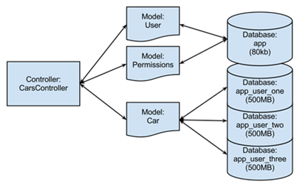
USE DATABASES
The USE db_name statement tells MySQL to use the db_name database as the default (current) database for subsequent statements. The database remains the default until the end of the session or another USE statement is issued.

Slide 94
USE DATABASES Syntax
USE db_name
\U db_name
Note:
USE, does not require a semicolon.
USE must be followed by a database name.
USE db1
\U db1

Slide 95
CREATE DATABASE
ALTER DATABASE

Slide 96
create / alter database
CREATE DATABASE creates a database with the given name. To use this statement, you need the CREATE privilege for the database.
CREATE {DATABASE | SCHEMA} [IF NOT EXISTS] db_name
ALTER {DATABASE | SCHEMA} [db_name] READ ONLY [=] { 0 | 1}
CREATE SCHEMA is a synonym for CREATE DATABASE.
CREATE DATABASE db1;
CREATE DATABASE IF NOT EXISTS db1;
ALTER DATABASE db1 READ ONLY = 0; // is in read write mode.
ALTER DATABASE db1 READ ONLY = 1; // is in read only mode.
Note:
It is not possible to Create, Alter, Drop any object, and Write (Insert, Update, and Delete rows) in a read-only database.
TEMPORARY tables; it is possible to create, alter, drop, and write (Insert, Update, and Delete rows) to TEMPORARY tables in a read-only database.

Slide 97
DROP DATABASE
If the default database is dropped, the default database is unset (the DATABASE() function returns NULL).

Slide 98
drop database
DROP DATABASE drops all tables in the database and deletes the database. Be very careful with this statement! To use DROP DATABASE, you need the DROP privilege on the database.
DROP {DATABASE | SCHEMA} [IF EXISTS] db_name
DROP SCHEMA is a synonym for DROP DATABASE.
DROP DATABASE db1;
DROP DATABASE IF EXISTS db1;

Slide 99
Information Functions
Use these function with SELECT statement

Slide 100
information function
FOUND_ROWS() - For a SELECT with a LIMIT clause, the number of rows that would be returned were there no LIMIT clause
e.g.
SELECT * FORM emp;
SELECT FOUND_ROWS();
LAST_INSERT_ID() - Value of the AUTOINCREMENT column for the last INSERT
ROW_COUNT() - The number of rows updated.
e.g.
SELECT * FORM emp;
SELECT ROW_COUNT();
DATABASE() - Return the default (current) database name
e.g.
SELECT DATABASE();
SCHEMA() - Synonym for DATABASE()

Slide 101
information function
CURRENT_USER(), CURRENT_USER - The authenticated user name and host name
USER() - The user name and host name provided by the client
e.g.
SELECT USER();
SESSION_USER() - Synonym for USER()
SYSTEM_USER() - Synonym for USER()
VERSION() - Return a string that indicates the MySQL server version
e.g.
SELECT VERSION();
CONNECTION_ID() - Return the connection ID (thread ID) for the connection

Slide 102
Source Command

Slide 103
Source command
You can execute an SQL script file using the source command or \. command
\. file_name
source file_name
\. 'D:\mysqldemobld7.sql'
SOURCE 'D:\mysqldemobld7.sql'
SOURCE //infoserver1/infodomain1/Everyone/DBT/mysqldemobld7.sql

Slide 104
SHOW COLUMNS

Slide 105
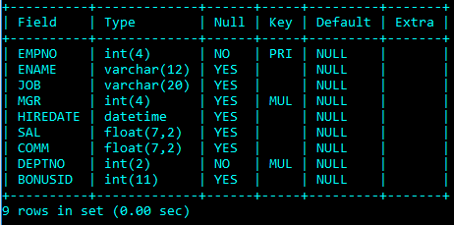
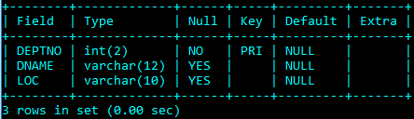
EMP & DEPT Table structure

Slide 106
SHOW COLUMNS Syntax
SHOW [FULL] {COLUMNS | FIELDS} {FROM | IN} tbl_name [{FROM | IN} db_name] [LIKE 'pattern' | WHERE expr]
SHOW COLUMNS FROM emp;
SHOW COLUMNS IN emp;
SHOW FULL COLUMNS FROM emp; # WITH PRIVILEGES
SHOW COLUMNS FROM emp FROM user01;
SHOW COLUMNS FROM user01.emp;
SHOW COLUMNS FROM emp LIKE 'E%’; # STARTING WITH E
SHOW COLUMNS FROM emp WHERE FIELD IN ('ename'); # ONLY ENAME COLUMN

Slide 107
SHOW TABLES

Slide 108
SHOW TABLES Syntax
SHOW [FULL] TABLES [{FROM | IN} db_name] [LIKE 'pattern' | WHERE expr]
SHOW TABLES;
SHOW FULL TABLES; // WITH TABLE TYPE
SHOW TABLES FROM USER01;
SHOW TABLES WHERE TABLES_IN_USER01 LIKE 'E%' OR TABLES_IN_USER01 LIKE 'B%';
SHOW TABLES WHERE TABLES_IN_USER01 IN ('EMP');

Slide 109
SHOW TABLES STATUS

Slide 110
SHOW TABLES STATUS Syntax
SHOW TABLE STATUS [{FROM | IN} db_name] [LIKE 'pattern' | WHERE expr]
SHOW TABLE STATUS;
SHOW TABLE STATUS FROM user01;
SHOW TABLE STATUS IN user01;
SHOW TABLE STATUS LIKE 'emp';

Slide 111
SHOW VARIABLES
shows the values of MySQL system variables.

Slide 112
SHOW VARIABLES Syntax
SHOW [GLOBAL | SESSION] VARIABLES [LIKE 'pattern' | WHERE expr]
SET SQL_SAFE_UPDATES = 0;
SET SQL_SAFE_UPDATES = false;
Enable/Disable :- 1 (true) / 0 (false)

Slide 113
explain analyze

Slide 114
explain
The DESCRIBE and EXPLAIN statements are synonyms. In practice, the DESCRIBE keyword is more often used to obtain information about table structure, whereas EXPLAIN is used to obtain a query execution plan.
{EXPLAIN | DESCRIBE | DESC}
tbl_name [col_name]
DESC emp;
DESC emp ename;
DESCRIBE emp;
EXPLAIN emp;
EXPLAIN emp empno;
EXPLAIN works with SELECT, DELETE, INSERT, REPLACE, and UPDATE statements.

Slide 115
explain
The DESCRIBE and EXPLAIN statements are synonyms. In practice, the DESCRIBE keyword is more often used to obtain information about table structure, whereas EXPLAIN is used to obtain a query execution plan.
{EXPLAIN | DESCRIBE | DESC}
{explainable_stmt}
explainable_stmt: {
SELECT statement
| DELETE statement
| INSERT statement
| REPLACE statement
| UPDATE statement
}
EXPLAIN ANALYZE SELECT * FROM emp;
EXPLAIN ANALYZE SELECT * FROM emp where empno = 7788;
EXPLAIN ANALYZE SELECT * FROM emp INNER JOIN dept USING(deptno);

Slide 116
The char is a fixed-length character data type,
The varchar is a variable-length character data type.
CREATE TABLE temp (c1 CHAR(10), c2 VARCHAR(10));
INSERT INTO temp VALUES('SALEEL', 'SALEEL');
SELECT * FROM temp WHERE c1 LIKE 'SALEEL';
datatypes
ENAME CHAR (10) | S | A | L | E | E | L |  |  |  |  | LENGTH -> 10
ENAME VARCHAR2(10) | S | A | L | E | E | L |  |  |  |  | LENGTH -> 6
When CHAR values are retrieved, the trailing spaces are removed (unless the PAD_CHAR_TO_FULL_LENGTHSQL mode is enabled)
In MySQL
ENAME CHAR (10) | S | A | L | E | E | L |  |  |  |  | LENGTH -> 6
ENAME VARCHAR(10) | S | A | L | E | E | L |  |  |  |  | LENGTH -> 6
Note:
The BINARY and VARBINARY types are similar to CHAR and VARCHAR, except that they store binary strings rather than nonbinary strings. That is, they store byte strings rather than character strings.

Slide 117
datatype - string
Datatypes | Size | Description
CHAR [(length)] | 0-255
VARCHAR (length) | 0 to 65,535 | The maximum row size (65,535 bytes, which is shared among all columns.
TINYTEXT [(length)] | (2⁸ − 1) bytes
TEXT [(length)] | (2¹⁶ -1) bytes | 65,535 bytes ~ 64kb
MEDIUMTEXT [(length)] | (2²⁴ -1) bytes | 16,777,215 bytes ~16MB
LONGTEXT [(length)] | (2³² -1) bytes | 4,294,967,295 bytes ~4GB
ENUM('value1', 'value2',...) | 65,535 members
SET('value1', 'value2',...) | 64 members
BINARY[(length)] | 255
VARBINARY(length)
By default, trailing spaces are trimmed from CHAR column values on retrieval. If PAD_CHAR_TO_FULL_LENGTH is enabled, trimming does not occur and retrieved CHAR values are padded to their full length.
SET sql_mode = '';
SET sql_mode = 'PAD_CHAR_TO_FULL_LENGTH';

Slide 118
example of char and varchar
Datatypes | Size | Description
CHAR [(length)] | 0-255
VARCHAR (length) | 0 to 65,535 | The maximum row size (65,535 bytes, which is shared among all columns.
In CHAR, if a table contains value 'a', an attempt to store 'a ' causes a duplicate-key error.
Try Out
CREATE TABLE x (x1 CHAR(4), x2 VARCHAR(4));
INSERT INTO x VALUE('', '');
INSERT INTO x VALUE('ab', 'ab');
INSERT INTO x VALUE('abcd', 'abcd');
SELECT x1, LENGTH(x1), x2, LENGTH(x2) FROM x;
SET sql_mode = 'PAD_CHAR_TO_FULL_LENGTH';
SELECT x1, LENGTH(x1), x2, LENGTH(x2) FROM x;
SET sql_mode = '';
SELECT x1, LENGTH(x1), x2, LENGTH(x2) FROM x;
CREATE TABLE x (x1 CHAR(4) PRIMARY KEY, x2 VARCHAR(4));
INSERT INTO x VALUE('a', 'a');
INSERT INTO x VALUE('a ', 'a ');
CREATE TABLE x (x1 CHAR(4), x2 VARCHAR(4) PRIMARY KEY);
INSERT INTO x VALUE('a', 'a');
INSERT INTO x VALUE('a ', 'a ');

Slide 119
example of text, blob, and longblob
Try Out
CREATE TABLE movies( _id INT AUTO_INCREMENT PRIMARY KEY, description TEXT, img1 BLOB, img2 LONGBLOB);
INSERT INTO movies VALUE(default, load_file("d:/movie1.txt") , load_file("d:/img1.jpg") , load_file("d:/img2.jpg") );
INSERT INTO movies VALUE(default, load_file("d:/movie2.txt") , load_file("d:/img1.jpg") , load_file("d:/img2.jpg") );
INSERT INTO movies VALUE(default, load_file("d:\\movie3.txt") , load_file("d:\\img1.jpg") , load_file("d:\\img2.jpg") );
SELECT * FROM movies;

Slide 120
datatype - numeric
Datatypes | Size | Description
TINYINT | 1 byte | -128 to +127 (The unsigned range is 0 to 255).
SMALLINT [(length)] | 2 bytes | -32768 to 32767. (The unsigned range is 0 to 65535).
MEDIUMINT [(length)] | 3 bytes | -8388608 to 8388607. (The unsigned range is 0 to 16777215).
INT, INTEGER [(length)] | 4 bytes | -2147483648 to 2147483647. (The unsigned range is 0 to 4294967295).
BIGINT [(length)] | 8 bytes | -9,223,372,036,854,775,808 to 9,223,372,036,854,775,807
FLOAT [(length[,decimals])] | 4 bytes | FLOAT(255,30)
DOUBLE [PRECISION] [(length[,decimals])], REAL [(length[,decimals])] | 8 bytes | REAL(255,30) / DOUBLE(255,30) REAL will get converted to DOUBLE
DECIMAL [(length[,decimals])], NUMERIC [(length[,decimals])] |  | DECIMAL(65,30) / NUMERIC(65,30) NUMERIC will get converted in DECIMAL
For: float(M,D), double(M,D) or decimal(M,D), M must be >= D
Here, (M,D) means than values can be stored with up to M digits in total, of which D digits may be after the decimal point.
UNSIGNED prohibits negative values.

Slide 121
datatype – date and time
Datatypes | Size | Description
YEAR | 1 byte | YYYY
DATE | 3 bytes | YYYY-MM-DD
TIME | 3 bytes | HH:MM:SS
DATETIME | 8 bytes | YYYY-MM-DD hh:mm:ss

Slide 122
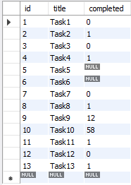
datatype – boolean
CREATE TABLE temp (col1 INT ,col2 BOOL, col3 BOOLEAN);
CREATE TABLE tasks ( id INT AUTO_INCREMENT PRIMARY KEY, title VARCHAR(255) NOT NULL, completed BOOLEAN);
INSERT INTO tasks VALUE(default, 'Task1', 0);
INSERT INTO tasks VALUE(default, 'Task2', 1);
INSERT INTO tasks VALUE(default, 'Task3', False);
INSERT INTO tasks VALUE(default, 'Task4', True);
INSERT INTO tasks VALUE(default, 'Task5', null);
INSERT INTO tasks VALUE(default, 'Task6', default);
INSERT INTO tasks VALUE(default, 'Task7’, 1 > 2);
INSERT INTO tasks VALUE(default, 'Task8’, 1 < 2);
INSERT INTO tasks VALUE(default, 'Task9', 12);
INSERT INTO tasks VALUE(default, 'Task10', 58);
INSERT INTO tasks VALUE(default, 'Task11', .75);
INSERT INTO tasks VALUE(default, 'Task12', .15);
INSERT INTO tasks VALUE(default, 'Task13', 'a' = 'a');
Note:
BOOL and BOOLEAN are synonym of TINYINT(1)

Slide 123
datatype – enum
An ENUM column can have a maximum of 65,535 distinct elements.
ENUM values are sorted based on their index numbers, which depend on the order in which the enumeration members were listed in the column specification.
Default value, NULL if the column can be NULL, first enumeration value if NOT NULL
CREATE TABLE temp (col1 INT, COL2 ENUM('A','B','C') NULL);
INSERT INTO temp (col1, col2) VALUES(1, 1);
INSERT INTO temp(col1) VALUES (1); // NULL
CREATE TABLE temp (col1 INT, col2 ENUM('A','B','C') NOT NULL);
INSERT INTO temp(col1) VALUES (1); // First element from the ENM datatype
CREATE TABLE temp (col1 INT, col2 ENUM('') NOT NULL);
INSERT INTO temp (col1, col2) VALUES (1,'THIS IS THE TEST'); // NULL
IMP:
MySQL maps [ membership ENUM('Silver', 'Gold', 'Diamond', 'Platinum') ] these enumeration member to a numeric index where Silver=1, Gold=2, Diamond=3, Platinum=4 respectively.

Slide 124
datatype – enum
An ENUM column can have a maximum of 65,535 distinct elements.
size ENUM('small', 'medium', 'large', 'x-large')
membership ENUM('Silver', 'Gold', 'Diamond', 'Platinum')
interest ENUM('Movie', 'Music', 'Concert')
zone ENUM('North', 'South', 'East', 'West')
season ENUM('Winter', 'Summer', 'Monsoon', 'Autumn')
sortby ENUM('Popularity', 'Price -- Low to High', 'Price -- High to Low', 'Newest First')
status ENUM('active', 'inactive', 'pending', 'expired', 'shipped', 'in-process', 'resolved', 'on-hold', 'cancelled', 'disputed')
Note:
You cannot use user variable as an enumeration value. This pair of statements do not work:
SET @mysize = 'medium';
CREATE TABLE sizes ( size ENUM('small', @mysize, 'large')); // error

Slide 125
datatype – set
A SET column can have a maximum of 64 distinct members.
A SET is a string object that can have zero or more values, each of which must be chosen from a list of permitted values specified when the table is created.
SET column values that consist of multiple set members are specified with members separated by commas (,).
CREATE TABLE clients(
id INT AUTO_INCREMENT PRIMARY KEY,
name VARCHAR(10),
membership ENUM('Silver', 'Gold', 'Diamond'),
interest SET('Movie', 'Music', 'Concert'));
INSERT INTO clients (name, membership, interest) VALUES('Saleel', 'Gold', 'Music');
INSERT INTO clients (name, membership, interest) VALUES('Saleel', 'Premium', 'Movie,Concert');
IMP:
The SET data type allows you to specify a list of values to be inserted in the column, like ENUM. But, unlike the ENUM data type, which lets you choose only one value, the SET data type allows you to choose multiple values from the list of specified values.

Slide 126
Use a CREATE TABLE statement to specify the layout of your table.
CREATE TABLE `123` (c1 INT, c2 VARCHAR(10));
Remember:
Max 4096 columns per table provided the row size <= 65,535 Bytes
create table
Use a CREATE TABLE statement to specify the layout of your table.
Note:
USER TABLES: This is a collection of tables created and maintained by the user. Contain USER information.
DATA DICTIONARY: This is a collection of tables created and maintained by the MySQL Server. It contains database information. All data dictionary tables are owned by the SYS user.

Slide 127
create table
Use a CREATE TABLE statement to specify the layout of your table.
Remember:
by default, tables are created in the default database, using the InnoDB storage engine.
table name should not begin with a number or special symbols
table name can start with _table_name (underscore) or $table_name (dollar sign)
table name and column name can have max 64 char.
multiple words as table_name is invalid, if you want to give multiple words as table_name then give it in `table_name` (backtick)
error occurs if the table exists.
error occurs if there is no default database.
error occurs if the database does not exist.
Note:
Table names are stored in lowercase on disk. MySQL converts all table names to lowercase on storage. This behavior also applies to database names and table aliases.
e.g. show variables like 'lower_case_table_names';

Slide 128
create table
syntax
e.g.
CREATE TABLE student (
ID INT,
firstName VARCHAR(45),
lastName VARCHAR(45),
DoB DATE,
emailID VARCHAR(128)
);
CREATE [TEMPORARY] TABLE [IF NOT EXISTS] tbl_name
(create_defineation, . . .)
[table_options]
[partition_options]
create_definition:
col_name column_definition
column_definition:
data_type [NOT NULL | NULL] [DEFAULT default_value]
[AUTO_INCREMENT] [UNIQUE [KEY] | [PRIMARY] KEY]
[reference_definition]
| data_type [GENERATED ALWAYS] AS (expression) [VIRTUAL]
[VISIBLE | INVISIBLE]
table_options:
ENGINE [=] engine_name
show engines;
set default_storage_engine = memory;

Slide 129
default value
The DEFAULT specifies a default value for the column.

Slide 130

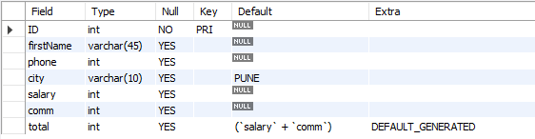
default value
col_name data_type DEFAULT value
The DEFAULT specifies a default value for the column.
CREATE TABLE posts (
postID INT,
postTitle VARCHAR(255),
postDate DATETIME DEFAULT NOW(),
deleted INT
);
# version 8.0 and above.
CREATE TABLE empl (
ID INT PRIMARY KEY,
firstName VARCHAR(45),
phone INT,
city VARCHAR(10) DEFAULT 'PUNE',
salary INT,
comm INT,
total INT DEFAULT(salary + comm)
);

Slide 131
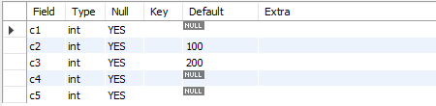
default value - insert
The DEFAULT example.
CREATE TABLE temp (
c1 INT,
c2 INT DEFAULT 100,
c3 INT DEFAULT 200,
c4 INT,
c5 INT
);
INSERT INTO temp VALUES();
INSERT INTO temp(c1, c2, c3, c4, c5) VALUES(1, DEFAULT, DEFAULT, 1, 1);
INSERT INTO temp(c1, c2, c3, c4, c5) VALUES(2, DEFAULT(c2), DEFAULT(c3), 2, 2);
INSERT INTO temp(c1, c2, c3, c4, c5) VALUES(3, DEFAULT(c3), DEFAULT(c2), 3, 3);

Slide 132
default value - update
The DEFAULT example.
CREATE TABLE temp (
c1 INT,
c2 INT,
c3 INT DEFAULT(c1 + c2),
c4 INT DEFAULT(c1 * c2 )
);
INSERT INTO temp(c1, c2, c3, c4) VALUES(1, 1, 1, 1);
INSERT INTO temp(c1, c2, c3, c4) VALUES(2, 2, 2, 2);
UPDATE temp SET c3 = DEFAULT;
UPDATE temp SET c4 = DEFAULT;

Slide 133
Note:
Your database table has X columns, Where as the VALUES you are passing are for (X-1) or (X+1). This mismatch of column-values will giving you the error.
Inserting a string into a string column (CHAR, VARCHAR, TEXT, or BLOB) that exceeds the column maximum length. The value is truncated to the column maximum length.
insert rows
INSERT command inserts new rows into an existing table.
You can insert data using following methods:
INSERT ... VALUES
INSERT ... SET
INSERT ... SELECT

Slide 134
insert rows using values

Slide 135
dml- insert … values
INSERT inserts new rows into an existing table. The INSERT ... VALUES
INSERT [IGNORE] [INTO] tbl_name [PARTITION (partition_name [, partition_name] ...)] [ (col_name, . . .) ] { VALUES | VALU E } ( { expr | DEFAULT }, . . .), (. . .), . . . [ ON DUPLICATE KEY UPDATE assignment_list ]
The affected-rows value for an INSERT can be obtained using the ROW_COUNT() function.
Column Values
Column List
Inserting multiple rows

Slide 136
dml- insert … values
INSERT inserts new rows into an existing table. The INSERT ... VALUES
INSERT [IGNORE] [INTO] tbl_name [PARTITION (partition_name [, partition_name] ...)] [ (col_name, . . .) ] { VALUES | VALUE } [ROW] ( { expr | DEFAULT }, . . .), [ROW] (. . .), [ROW] . . . [ ON DUPLICATE KEY UPDATE assignment_list ]
CREATE TABLE student (
ID INT PRIMARY KEY,
nameFirst VARCHAR(45),
nameLast VARCHAR(45),
DoB DATE ,
emailID VARCHAR(128)
);
e.g.
INSERT INTO student VALUES (29, 'sharmin', 'patil', '1999-11-10', 'sharmin.patil@gmail.com’);
INSERT INTO student (ID, nameFirst, nameLast, DOB, emailID) VALUES (30, 'john', 'thomas', '1983-11-10', 'john.thomas@gmail.com’);
INSERT INTO student (ID, nameFirst, emailID) VALUES (31, 'jack', 'jack.thorn@gmail.com’);
INSERT INTO student (ID, nameFirst) VALUES (32, 'james'), (33, 'jr. james'), (34, 'sr. james');

Slide 137
insert rows using select

Slide 138
insert ... select
With INSERT ... SELECT, you can quickly insert many rows into a table from one or many tables.
INSERT [INTO] tbl_name [(col_name, . . .)] SELECT . . .
INSERT INTO dept(deptno) SELECT 1 + 1;
INSERT INTO dept(deptno) SELECT deptno FROM dept;
INSERT INTO dept SELECT * FROM dept;
INSERT INTO dept(SELECT MAX(deptno) + 1, 'HRD', 'BARODA', 'r57px33px' FROM dept);
set @x := 40;
INSERT INTO dept VALUES (@x := @x + 1 , 'HRD', 'BARODA', 'r57px33px');
set @x := (SELECT MAX(deptno) FROM dept);
INSERT INTO dept VALUES (@x := @x + 1 , 'HRD', 'BARODA', 'r57px33px');

Slide 139
Do not use the * operator in your SELECT statements. Instead, use column names. Reason is that in MySQL Server scans for all column names and replaces the * with all the column names of the table(s) in the SELECT statement. Providing column names avoids this search-and-replace, and enhances performance.
SELECT statement…
SELECT what_to_select
FROM which_table
WHERE conditions_to_satisfy;

Slide 140
SELECT CLAUSE
The SELECT statement retrieves or extracts data from tables in the database.
You can use one or more tables separated by comma to extract data.
You can fetch one or more fields/columns in a single SELECT command.
You can specify star (*) in place of fields. In this case, SELECT will return all the fields.
SELECT can also be used to retrieve rows computed without reference to any table e.g. SELECT 1 + 2;

Slide 141
Capabilities of SELECT Statement
SELECTION
PROJECTION
JOINING

Slide 142
Capabilities of SELECT Statement
SELECTION
Selection capability in SQL is to choose the rows in a table that you want to return by a query.
R
EMPNO | ENAME | JOB | HIREDATE | DEPTNO
1 | Saleel | Manager | 1995-01-01 | 10
2 | Janhavi | Sales | 1994-12-20 | 20
3 | Snehal | Manager | 1997-05-21 | 10
4 | Rahul | Account | 1997-07-30 | 10
5 | Ketan | Sales | 1994-01-01 | 30

Slide 143
Capabilities of SELECT Statement
PROJECTION
Projection capability in SQL to choose the columns in a table that you want to return by your query.
R
EMPNO | ENAME | JOB | HIREDATE | DEPTNO
1 | Saleel | Manager | 1995-01-01 | 10
2 | Janhavi | Sales | 1994-12-20 | 20
3 | Snehal | Manager | 1997-05-21 | 10
4 | Rahul | Account | 1997-07-30 | 10
5 | Ketan | Sales | 1994-01-01 | 30

Slide 144
Capabilities of SELECT Statement
JOINING
Join capability in SQL to bring together data that is stored in different tables by creating a link between them.
R
S
EMPNO | ENAME | JOB | HIREDATE | DEPTNO
1 | Saleel | Manager | 1995-01-01 | 20
2 | Janhavi | Sales | 1994-12-20 | 10
3 | Snehal | Manager | 1997-05-21 | 10
4 | Rahul | Account | 1997-07-30 | 20
5 | Ketan | Sales | 1994-01-01 | 30
DEPTNO | DNAME | LOC
10 | HRD | PUNE
20 | SALES | BARODA
40 | PURCHASE | SURAT

Slide 145
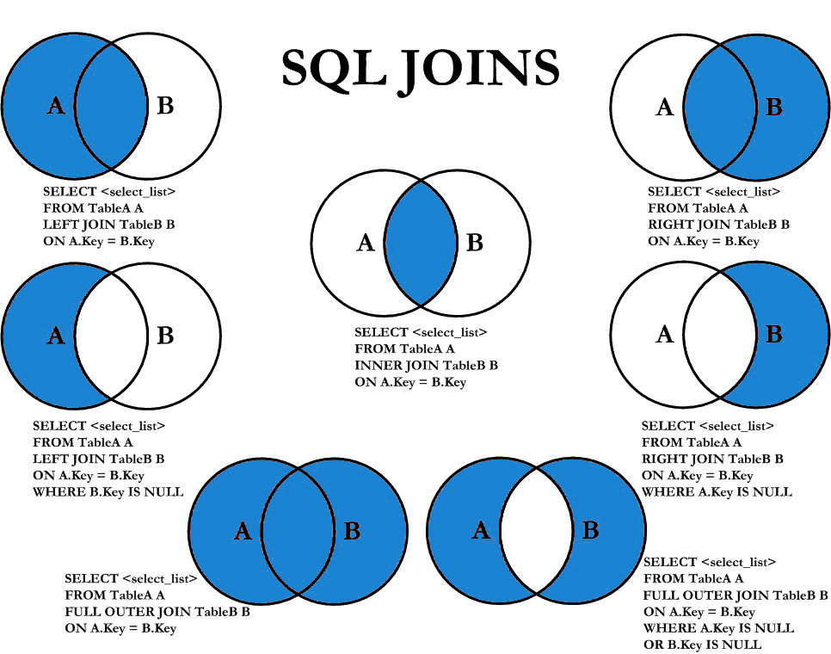

Slide 146
select statement
SELECTION Process
SELECT * FROM <table_references>
selection-list | field-list | column-list
Remember:
Here, " * " is known as metacharacter (all columns)
PROJECTION Process
SELECT column-list FROM <table_references>
selection-list | field-list | column-list
Remember:
Position of columns in SELECT statement will determine the position of columns in the output (as per user requirements)

Slide 147
ORDER BY in UPDATE: if the table contains two values 1 and 2 in the id column and 1 is updated to 2 before 2 is updated to 3, an error occurs. To avoid this problem, add an ORDER BY clause to cause the rows with larger id values to be updated before those with smaller values.
Note:
Here c1 column is a Primary Key
UPDATE temp SET c1 = c1 - 1 ORDER BY c1 ASC; # In case of decrement
UPDATE temp SET c1 = c1 + 1 ORDER BY c1 DESC; # In case of increment
In a SET statement, = is treated identically to :=
single-table update
SET @x := 0;
UPDATE emp SET id = @x := @x + 1;
UPDATE t, (SELECT isactive, COUNT(isactive) r1 FROM emp GROUP BY isactive) a SET t.c2 = a.r1 WHERE t.c1 = a.isactive;
mysql> SELECT * FROM t;
+-------+--------+
| c1 | c2 |
+-------+--------+
| 0 | NULL |
| 1 | NULL |
+-------+--------+
+-------+------+
| c1 | c2 |
+-------+------+
| 0 | 6 |
| 1 | 14 |
+-------+------+
e.g.
Update top 2 rows.
Update UnitPrice for the top 5 most expensive products.

Slide 148
single-table update
The UPDATE statement updates columns of existing rows in the named table with new values. The SET clause indicates which columns to modify and the values they should be given. The WHERE clause, if given, specifies the conditions that identify which rows to update. With no WHERE clause, all rows are updated. If the ORDER BY clause is specified, the rows are updated in the order that is specified. The LIMIT clause places a limit on the number of rows that can be updated.
UPDATE tbl_name SET col_name1 = { expr1 | DEFAULT } [, col_name2 = { expr2 | DEFAULT } ] . . .
[WHERE where_condition]
[ORDER BY . . .]
[LIMIT row_count]
UPDATE temp SET dname = 'new_value' LIMIT 2;
UPDATE temp SET c1 = 'new_value' ORDER BY loc LIMIT 2;
UPDATE temp SET c1 := 'new_value' WHERE deptno < 50;
UPDATE temp SET c1 := 'new_value' WHERE deptno < 50 LIMIT 2;
ALTER TABLE dept ADD SUMSALARY INT;
UPDATE dept SET sumsalary = (SELECT SUM(sal) FROM emp WHERE emp.deptno = dept.deptno GROUP BY emp.deptno);
UPDATE candidate SET totalvotes = (SELECT COUNT(*) FROM votes WHERE candidate.id = votes.candidateID GROUP BY votes.candidateID);
UPDATE duplicate SET id = ( SELECT @cnt := @cnt + 1 );

Slide 149
single-table delete

Slide 150
single-table delete
The DELETE statement deletes rows from tbl_name and returns the number of deleted rows. To check the number of deleted rows, call the ROW_COUNT() function. The optional WHERE clause identify which rows to delete. With no WHERE clause, all rows are deleted. If the ORDER BY clause is specified, the rows are deleted in the order that is specified. The LIMIT clause places a limit on the number of rows that can be deleted.
DELETE FROM tbl_name
[PARTITION (partition_name [, partition_name] . . .)]
[WHERE where_condition]
[ORDER BY . . .]
[LIMIT row_count]
Note:
LIMIT clauses apply to single-table deletes, but not multi-table deletes.
DELETE FROM temp;
DELETE FROM temp ORDER BY loc LIMIT 2;
DELETE FROM temp WHERE deptno < 50;
DELETE FROM temp WHERE deptno < 50 LIMIT 2;

Slide 151
auto_increment column
The AUTO_INCREMENT attribute can be used to generate a unique number/identity for new rows.

Slide 152
auto_increment
IDENTITY is a synonym to the LAST_INSERT_ID variable.
col_name data_type AUTO_INCREMENT [UNIQUE [KEY] | [PRIMARY] KEY]
Remember:
There can be only one AUTO_INCREMENT column per table.
it must be indexed.
it cannot have a DEFAULT value.
it works properly only if it contains only positive values.
It applies only to integer and floating-point types.
when you insert a value of NULL or 0 into AUTO_INCREMENT column, it generates next value.
use LAST_INSERT_ID() function to find the row that contains the most recent AUTO_INCREMENT value.
SELECT @@IDENTITY
SELECT LAST_INSERT_ID()
SET INSERT_ID = 7
CREATE TABLE posts (
c1 INT UNIQUE KEY AUTO_INCREMENT,
c2 VARCHAR(20)
) AUTO_INCREMENT = 2; // auto_number will start with value 2.

Slide 153


auto_increment
The auto_increment specifies a auto_increment value for the column.
CREATE TABLE posts (
postID INT AUTO_INCREMENT UNIQUE KEY,
postTitle VARCHAR(255),
postDate DATETIME DEFAULT NOW(),
deleted INT
);
CREATE TABLE comments (
commentID INT AUTO_INCREMENT PRIMARY KEY,
comment TEXT,
commentDate DATETIME DEFAULT NOW(),
deleted INT
);

Slide 154
CREATE TABLE . . . LIKE . . ., the destination table preserves generated column information from the original table.
CREATE TABLE . . . SELECT . . ., the destination table does not preserves generated column information from the original table.
generated column
Remember:
Stored functions and user-defined functions are not permitted.
Stored procedure and function parameters are not permitted.
Variables (system variables, user-defined variables, and stored program local variables) are not permitted.
Subqueries are not permitted.
The AUTO_INCREMENT attribute cannot be used in a generated column definition.
Triggers cannot use NEW.COL_NAME or use OLD.COL_NAME to refer to generated columns.
Stored column cannot be converted to virtual column and virtual column cannot be converted to stored column.
Generated column can be made as invisible column.
Note:
The expression can contain literals, built-in functions with no parameters, operators, or references to any column within the same table. If you use a function, it must be scalar and deterministic.

Slide 155
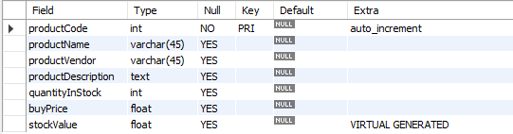
virtual column - generated always
col_name data_type [GENERATED ALWAYS] AS (expression) [VIRTUAL | STORED]
VIRTUAL: Column values are not stored, but are evaluated when rows are read, immediately after any BEFORE triggers. A virtual column takes no storage.
STORED: Column values are evaluated and stored when rows are inserted or updated. A stored column does require storage space and can be indexed.
Note:
The default is VIRTUAL if neither keyword is specified.
CREATE TABLE product(
productCode INT AUTO_INCREMENT PRIMARY KEY,
productName VARCHAR(45),
productVendor VARCHAR(45),
productDescription TEXT,
quantityInStock INT,
buyPrice FLOAT,
stockValue FLOAT GENERATED ALWAYS AS(quantityInStock * buyPrice) VIRTUAL
);

Slide 156
virtual column – MODIFY with ALTER command
PROBLEMS
col_name data_type [GENERATED ALWAYS] AS (expression) [VIRTUAL | STORED]
Note:
Virtual column cannot be converted to stored column.
CREATE TABLE product1(
productCode INT,
quantityInStock INT,
buyPrice INT,
stockValue FLOAT GENERATED ALWAYS AS (quantityInStock * buyPrice) VIRTUAL
);
ALTER TABLE product1 MODIFY stockValue FLOAT (12, 2); // error: We are trying to convert virtual column [ GENERATED ALWAYS AS ] to stored column by not giving GENERATED ALWAYS AS
Then What-→ give
ALTER TABLE product1 MODIFY stockValue FLOAT (12, 2) GENERATED ALWAYS AS (quantityInStock * buyPrice) VIRTUAL ;

Slide 157
virtual column – MODIFY with ALTER command
PROBLEMS
col_name data_type [GENERATED ALWAYS] AS (expression) [VIRTUAL | STORED]
Note:
Stored column cannot be converted to virtual column.
CREATE TABLE product1(
productCode INT,
quantityInStock INT,
buyPrice INT,
stockValue FLOAT
);
ALTER TABLE product1 MODIFY stockValue FLOAT GENERATED ALWAYS AS (quantityInStock * buyPrice) VIRTUAL; // error: We are trying to convert stored column to virtual column by giving GENERATED ALWAYS AS

Slide 158
visible / invisible columns
Columns are visible by default. To explicitly specify visibility for a new column, use a VISIBLE or INVISIBLE keyword as part of the column definition for CREATE TABLE or ALTER TABLE.
Note:
An invisible column is normally hidden to queries, but can be accessed if explicitly referenced. Prior to MySQL 8.0.23, all columns are visible.
A table must have at least one visible column. Attempting to make all columns invisible produces an error.
SELECT * does not include invisible columns.

Slide 159
invisible column
col_name data_type INVISIBLE
CREATE TABLE employee (
ID INT AUTO_INCREMENT PRIMARY KEY,
firstName VARCHAR(40),
salary INT,
commission INT,
total INT DEFAULT(salary + commission) INVISIBLE
tax INT GENERATED ALWAYS AS (total * .25) VIRTUAL INVISIBLE
) ;
CREATE TABLE employee (
ID INT PRIMARY KEY AUTO_INCREMENT INVISIBLE ,
firstName VARCHAR(40)
) ;
INSERT INTO employee(firstName, salary, commission) VALUES('ram', 4700, -700);
INSERT INTO employee(firstName, salary, commission) VALUES('pankaj', 3400, NULL);
INSERT INTO employee(firstName, salary, commission) VALUES('rajan', 3200, 250);
INSERT INTO employee(firstName, salary, commission) VALUES('ninad', 2600, 0);
INSERT INTO employee(firstName, salary, commission) VALUES('omkar', 4500, 300);
SELECT * FROM employee;
ALTER TABLE employee MODIFY total INT VISIBLE;
ALTER TABLE employee MODIFY total INT INVISIBLE;

Slide 160
varbinary column
TODO
Note:
TODO
TODO
TODO

Slide 161
varbinary column
col_name VARBINARY
CREATE TABLE login (
ID INT AUTO_INCREMENT PRIMARY KEY,
userName VARCHAR(40),
password VARBINARY(40) INVISIBLE
) ;
INSERT INTO login(userName, password) VALUES('ram', 'ram@123');
INSERT INTO login(userName, password) VALUES('pankaj', 'pankaj');
INSERT INTO login(userName, password) VALUES('rajan', 'rajan');
INSERT INTO login(userName, password) VALUES('ninad', 'ninad');
INSERT INTO login(userName, password) VALUES('omkar', 'omkar');
SELECT * FROM login;
SELECT username, CAST(password as CAST) FROM login;

Slide 162
a1 INT(10) zerofill |  |  |  |  |  |  | 1 | 5 | 0 | 0
a2 INT(10) |  |  |  |  |  |  | 3 | 6 | 7 | 5
0 | 0 | 0 | 0 | 0 | 0 | 1 | 5 | 0 | 0 | length(ID1) -> 10
 |  |  |  |  |  | 3 | 6 | 7 | 5 | length(ID2) -> 4
zerofill value
When you select a column with the type ZEROFILL it pads the displayed value of the field with zeros up to the display width specified in the column definition.
Note:
ZEROFILL attribute is use for numeric datatype.
If you specify ZEROFILL for a column, MySQL automatically adds the UNSIGNED attribute to the column.

Slide 163
zerofill column
col_name data_type ZEROFILL
CREATE TABLE employee (
ID INT ZEROFILL AUTO_INCREMENT PRIMARY KEY,
firstName VARCHAR(40),
salary INT,
commission INT,
total INT DEFAULT(salary + commission)
) ;
INSERT INTO employee VALUES(NULL, 'ram', 4700, NULL, default);
INSERT INTO employee VALUES(0, 'pankaj', 3400, 400 , default);
INSERT INTO employee VALUES(100, 'rajan', 3200, NULL , default);
INSERT INTO employee VALUES(NULL, 'ninad', 2600, 0, default);
INSERT INTO employee VALUES(0, 'omkar', 4500, 300, default);
INSERT INTO employee VALUES (-200, 'rahul', 3000, 300 , default);
SELECT * FROM employee;
SELECT ID, LENGTH(ID), salary, LENGTH(salary) FROM employee;

Slide 164
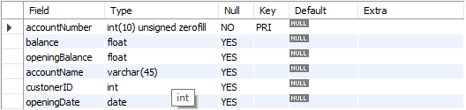
zerofill column
CREATE TABLE account (
accountNumber INT ZEROFILL PRIMARY KEY,
balance FLOAT,
openingBalance FLOAT,
accountName VARCHAR(45),
custonerID INT,
openingDate DATE
);
Note:
If you specify ZEROFILL for a numeric column, MySQL automatically adds the UNSIGNED attribute to the column.

Slide 165
constraints
CONSTRAINT is used to define rules to allow or restrict what values can be stored in columns. The purpose of inducing constraints is to enforce the integrity of a database.
CONSTRAINTS can be classified into two types –
Column Level
Table Level
The column level constraints can apply only to one column where as table level constraints are applied to the entire table.

Slide 166
Remember:
PRI => primary key
UNI => unique key
MUL=> is basically an index that is neither a primary key nor a unique key. The name comes from
"multiple" because multiple occurrences of the same value are allowed.
constraints
To limit or to restrict or to check or to control.
Note:
a table with a foreign key that references another table's primary key is MUL.
If more than one of the Key values applies to a given column of a table, Key displays the one with the highest priority, in the order PRI, UNI, and MUL.

Slide 167
Keys are used to establish relationships between tables and also to uniquely identify any record in the table.
types of Keys?
r = Employee(EmployeeID, FullName, job, salary, PAN, DateOfBirth, emailID, deptno)
Candidate Key: are individual columns in a table that qualifies for uniqueness of all the rows. Here in Employee table EmployeeID, PAN or emailID are Candidate keys.
Primary Key: is the columns you choose to maintain uniqueness in a table. Here in Employee table you can choose either EmployeeID, PAN or emailID columns, EmployeeID is preferable choice.
Alternate Key: Candidate column other the primary key column, like if EmployeeID is primary key then , PAN or emailID columns would be the Alternate key.
Super Key: If you add any other column to a primary key then it become a super key, like EmployeeID + FullName is a Super Key.
Composite Key: If a table do not have any single column that qualifies for a Candidate key, then you have to select 2 or more columns to make a row unique. Like if there is no EmployeeID, PAN or emailID columns, then you can make FullName + DateOfBirth as Composite key. But still there can be a narrow chance of duplicate row.

Slide 168
Candidate Key
Primary Key
Composite Key
Alternate Key

Slide 169
Remember:
A primary key cannot be NULL.
A primary key value must be unique.
A table has only one primary key.
The primary key values cannot be changed, if it is referred by some other column.
The primary key must be given a value when a new record is inserted.
An index can consist of 16 columns, at maximum. Since a PRIMARY KEY constraint automatically adds an index, it can't have more than 16 columns.
PRIMARY KEY constraint
Choosing a primary key is one of the most important steps in good database design. A primary key is a column that serves a special purpose. A primary key is a special column (or set of combined columns) in a relational database table, that is used to uniquely identify each record. Each database table needs a primary key.
Note:
Primary key in a relation is always associated with an INDEX object.
If, we give on a column a combination of NOT NULL & UNIQUE key then it behaves like a PRIMARY key.
If, we give on a column a combination of UNIQUE key & AUTO_INCREMENT then also it behaves like a PRIMARY key.

Slide 170
clustered and non-clustered index
Indexing in MySQL is a process that helps us to return the requested data from the table very fast. If the table does not have an index, it scans the whole table for the requested data.
MySQL allows two different types of Indexing:
Clustered Index
Non-Clustered Index
Clustered Index:- The InnoDB table uses a clustered index for optimizing the speed of most common lookups ( SELECT statement) and DML operations like INSERT, UPDATE, and DELETE command. Clustered indexes sort and store the data rows in the table based on their key values that can be sorted in only one way. If the table column contains a primary key or unique key, MySQL creates a clustered index named PRIMARY based on that specific column.
Non-Clustered Index:- The indexes other than PRIMARY indexes (i.e. clustered indexes) called a non-clustered index. The non-clustered indexes are also known as secondary indexes. The non-clustered index and table data are both stored in different places. It is not sorted (ordering) the table data.
CREATE TABLE test(c1 INT, c2 INT, c3 INT, c4 INT,c5 INT, c6 INT, c7 INT, c8 INT, c9 INT, c10 INT, c11 INT, c12 INT, c13 INT, c14 INT, c15 INT, c16 INT, c17 INT, c18 INT, c19 INT, c20 INT, PRIMARY KEY (c1, c2, c3, c4, c5, c6, c7, c8, c9, c10, c11, c12, c13, c14, c15, c16, c17, c18 )); // error

Slide 171
constraints – add primary key
col_name data_type PRIMARY KEY
The following example creates tables with PRIMARY KEY column.
CREATE TABLE users (
ID INT PRIMARY KEY,
userName VARCHAR(25),
password VARCHAR(25),
email VARCHAR(255)
) ;
CREATE TABLE purchase_orders (
po_number INT,
vendor_id INT NOT NULL,
po_status INT NOT NULL,
PRIMARY KEY(po_number)
);
CREATE TABLE supplier (
supplier_id INT,
supplier_name VARCHAR(50),
contact_name VARCHAR(50),
constraint pk_supplier_id PRIMARY KEY(supplier_id)
);
CREATE TABLE person (
ID INT NOT NULL UNIQUE,
lastName VARCHAR(45),
firstName VARCHAR(45),
age INT,
email VARCHAR(255)
);

Slide 172
constraints – add composite primary key
The following example creates tables with COMPOSITE PRIMARY KEY column.
CREATE TABLE salesDetails (
customerID INT,
productID INT,
timeID INT,
qty INT,
salesDate DATE,
salesAmount INT,
PRIMARY KEY(customerID , productID, timeID)
) ;
customerID | productID | timeID | quantity | salesDate | salesAmount
Cust-001 | PRD-1 | D1-T1 | 100 | ●●●●●● | 25,00,000
Cust-001 | PRD-1 | D2-T1 | 100 | ●●●●●● | 25,00,000
Cust-001 | PRD-2 | D1-T1 | 200 | ●●●●●● | 50,00,000
Cust-002 | PRD-1 | D1-T1 | 100 | ●●●●●● | 25,00,000
Cust-004 | PRD-1 | D1-T1 | 100 | ●●●●●● | 25,00,000
Cust-004 | PRD-2 | D3-T1 | 200 | ●●●●●● | 50,00,000

Slide 173
constraints – add composite primary key
The following example creates tables with COMPOSITE PRIMARY KEY column.
CREATE TABLE payments (
paymentID INT,
orderID INT,
amount INT,
bankDetails VARCHAR(255),
PRIMARY KEY(paymentID , orderID)
) ;
CREATE TABLE order_product (
orderID INT,
productID INT,
qty INT,
rate INT,
constraint pk_orderID_productID PRIMARY KEY(orderID, productID)
) ;

Slide 174
ALTER TABLE table_name
ADD [ CONSTRAINT constraint_name ]
PRIMARY KEY (column1, column2, . . . column_n)
Add Primary Key using Alter

Slide 175
constraints – add primary key using alter
You can use the ALTER TABLE statement to ADD PRIMARY KEY on existing column.
ALTER TABLE table_name
ADD [ CONSTRAINT constraint_name ]
PRIMARY KEY (column1, column2, . . . column_n)
CREATE TABLE vendors (
vendor_id INT,
vendor_name VARCHAR(25),
address VARCHAR(255)
);
ALTER TABLE vendors ADD PRIMARY KEY(vendor_id);
ALTER TABLE vendors ADD constraint pk_vendor_id PRIMARY KEY(vendor_id);

Slide 176
ALTER TABLE table_name
DROP PRIMARY KEY
Drop Primary Key

Slide 177
constraints – drop primary key
You can use the ALTER TABLE statement to DROP PRIMARY KEY.
ALTER TABLE table_name
DROP PRIMARY KEY
CREATE TABLE vendors (
vendor_id INT,
vendor_name VARCHAR(25),
address VARCHAR(255)
);
ALTER TABLE vendors DROP PRIMARY KEY;

Slide 178
Remember:
A unique key can be NULL.
A unique key value must be unique.
A table can have multiple unique key.
A column can have unique key as well as a primary key.
UNIQUE KEY constraint
A UNIQUE key constraint is a set of one or more than one fields/columns of a table that uniquely identify a record in a database table.
Note:
Unique key in a relation is always associated with an INDEX object.

Slide 179
constraints – add unique key
col_name data_type UNIQUE KEY
The following example creates table with UNIQUE KEY column.
CREATE TABLE clients (
client_id INT,
first_name VARCHAR(50),
last_name VARCHAR(50),
company_name VARCHAR(255),
email VARCHAR(255) UNIQUE
);
CREATE TABLE contacts (
ID INT,
first_name VARCHAR(50),
last_name VARCHAR(50),
phone VARCHAR(15),
UNIQUE(phone)
);
CREATE TABLE brands (
ID INT,
brandName VARCHAR(30),
constraint uni_brandName UNIQUE(brandName)
);
SHOW INDEX FROM clients;

Slide 180
ALTER TABLE table_name
ADD [ CONSTRAINT constraint_name ]
UNIQUE (column1, column2, . . . column_n)
Add Unique Key using Alter

Slide 181
constraints – add unique key using alter
You can use the ALTER TABLE statement to ADD UNIQUE KEY on existing column.
ALTER TABLE table_name
ADD [ CONSTRAINT constraint_name ]
UNIQUE (column1, column2, . . . column_n)
CREATE TABLE shop (
ID INT,
shop_name VARCHAR(30)
);
ALTER TABLE shop ADD UNIQUE(shop_name);
ALTER TABLE shop ADD constraint uni_shop_name UNIQUE(shop_name);

Slide 182
ALTER TABLE table_name
DROP INDEX constraint_name;
Drop Unique Key

Slide 183
constraints – drop unique key
You can use the ALTER TABLE statement to DROP UNIQUE KEY.
ALTER TABLE table_name
DROP INDEX constraint_name;
SELECT table_name, constraint_name, constraint_type FROM information_schema.table_constraints WHERE constraint_schema = 'z' AND table_name IN ('A', 'B');
ALTER TABLE users DROP INDEX <COLUMN_NAME>;
ALTER TABLE users DROP INDEX U_USER_ID; #CONSTRAINT NAME
CREATE TABLE users (
ID INT PRIMARY KEY,
userName VARCHAR(40),
password VARCHAR(255),
email VARCHAR(255) UNIQUE KEY
) ;
CREATE TABLE users (
ID INT PRIMARY KEY,
userName VARCHAR(40),
password VARCHAR(255),
email VARCHAR(255),
constraint uni_email UNIQUE KEY(email)
) ;
ALTER TABLE users DROP INDEX email;
ALTER TABLE users DROP INDEX uni_email;

Slide 184
FOREIGN KEY constraint
A FOREIGN KEY is a key used to link two tables together. A FOREIGN KEY is a field (or collection of fields) in one table that refers to the PRIMARY KEY in another table. The table containing the foreign key is called the child table, and the table containing the candidate key is called the referenced or parent table.

Slide 185
constraints – foreign key
Remember:
A foreign key can have a different column name from its primary key.
DataType of primary key and foreign key column must be same.
It ensures rows in one table have corresponding rows in another.
Unlike the Primary key, they do not have to be unique.
Foreign keys can be null even though primary keys can not.
Note:
The table containing the FOREIGN KEY is referred to as the child table, and the table containing the PRIMARY KEY (referenced key) is the parent table.
PARENT and CHILD tables must use the same storage engine,
and they cannot be defined as temporary tables.

Slide 186
insert, update, & delete – (primary key/foreign key)
A referential constraint could be violated in following cases.
An INSERT attempt to add a row to a child table that has a value in its foreign key columns that does not match a value in the corresponding parent table's column.
An UPDATE attempt to change the value in a child table's foreign key columns to a value that has no matching value in the corresponding parent table's parent key.
An UPDATE attempt to change the value in a parent table's parent key to a value that does not have a matching value in a child table's foreign key columns.
A DELETE attempt to remove a record from a parent table that has a matching value in a child table's foreign key columns.
Note:
PARENT and CHILD tables must use the same storage engine,
and they cannot be defined as temporary tables.
If we don’t give constraint name. System will automatically generated the constraint name and will assign to foreign key constraint. e.g. login_ibfk_1, login_ibfk_2, …..

Slide 187
anomaly – (primary key/foreign key)
Remember:
Student (parent) Table
student_course (child) Table
RollNo | Name | Mobile | City | State | isActive
1 | Ramesh | ●●●● | Pune | MH | 1
2 | Amit | ●●●● | Baroda | GJ | 1
3 | Rajan | ●●●● | Surat | GJ | 1
4 | Bhavin | ●●●● | Baroda | GJ | 1
5 | Pankaj | ●●●● | Surat | GJ | 1
RollNo | CourceDuration | CourceName
1 | 1.5 month | RDBMS
2 | 1.2 month | NoSQL
3 | 2 month | Networking
1 | 2 month | Java
2 | 2 month | .NET
Insertion anomaly:
If we try to insert a record in Student_Course (child) table with RollNo = 7, it will not allow.
Updation and Deletion anomaly:
If you try to chance the RollNo from Student (parent) table with RollNo = 6 whose RollNo = 1 , it will not allow.
If you try to chance the RollNo from Student_Course (child) table with RollNo = 9 whose RollNo = 3 , it will not allow.
If we try to delete a record from Student (parent) table with RollNo = 1, it will not allow.

Slide 188
alter, drop – (primary key/foreign key)
Remember:
Parent Table
student = {
rollno INT, * (PK)
name VARCHAR(10),
mobile VARCHAR(10),
city VARCHAR(10),
state VARCHAR(10),
isActive BOOL
}
Child Table
student_course = {
rollno INT, * (FK)
courceduration VARCHAR(10),
courcename VARCHAR(10)
}
DDL command could be violated in following cases.
Alter command:
If we try to modify datatype of RollNo in Student or Student_Course table with VARCHAR, it will not allow.
If we try to apply auto_increment to RollNo in Student table, it will not allow
If we try to drop RollNo column from Student table , it will not allow.
Drop command:
If we try to drop Student (parent) table, it will not allow.

Slide 189
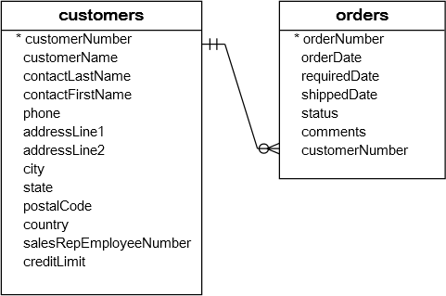
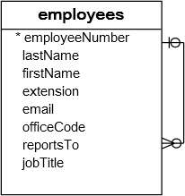
constraints – foreign key
A foreign key is a field in a table that matches another field of another table. A foreign key places constraints on data in the related tables, which enables MySQL to maintain referential integrity.
The customers table is called parent table or referenced table, and the orders table is known as child table or referencing table.

Slide 190
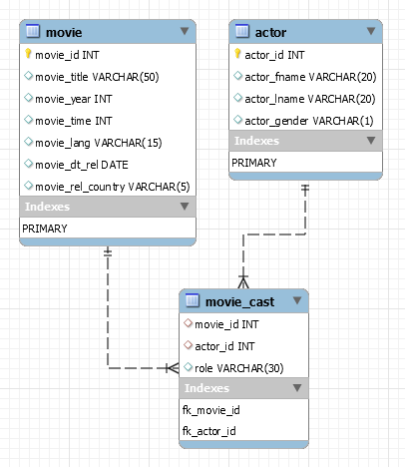
constraints – foreign key
A foreign key is a field in a table that matches another field of another table. A foreign key places constraints on data in the related tables, which enables MySQL to maintain referential integrity.
CREATE TABLE movie (
movie_id INT PRIMARY KEY,
movie_title VARCHAR(50),
movie_year INT,
movie_time INT,
movie_lang VARCHAR(15),
movie_dt_rel DATE,
movie_rel_country VARCHAR(5)
);
CREATE TABLE actor (
actor_id INT PRIMARY KEY,
actor_fname VARCHAR(20),
actor_lname VARCHAR(20),
actor_gender VARCHAR(1)
);
CREATE TABLE movie_cast (
movie_id INT,
actor_id INT,
role VARCHAR(30),
constraint fk_movie_id FOREIGN KEY(movie_id) REFERENCES movie(movie_id),
constraint fk_actor_id FOREIGN KEY(actor_id) REFERENCES actor(actor_id)
);

Slide 191
QUESTION – find foreign key columns
The following example find Foreign Key columns.
CREATE TABLE owner (
owner_id INT PRIMARY KEY,
first_name VARCHAR(50),
last_name VARCHAR(50),
email VARCHAR(255)
);
CREATE TABLE contacts (
contact_id INT PRIMARY KEY,
owner_id INT,
contact_number VARCHAR(15)
);
CREATE TABLE shop (
shop_id INT,
owner_id INT,
shop_name VARCHAR(30)
);
CREATE TABLE shop_brand (
ID INT PRIMARY KEY,
shop_id INT,
brand_id INT
);
CREATE TABLE brands (
brand_id INT PRIMARY KEY,
brand_name VARCHAR(30) UNIQUE
);

Slide 192
ALTER TABLE table_name
ADD [ CONSTRAINT constraint_name ]
FOREIGN KEY (child_col1, child_col2, . . . child_col_n)
REFERENCES parent_table (parent_col1, parent_col2, . . . parent_col_n);
Add Foreign Key Constraint using Alter

Slide 193
constraints – add foreign key using alter
You can use the ALTER TABLE statement to ADD FOREIGN KEY on existing column.
ALTER TABLE table_name
ADD [ CONSTRAINT constraint_name ]
FOREIGN KEY (child_col1, child_col2, . . . child_col_n)
REFERENCES parent_table (parent_col1, parent_col2, . . . parent_col_n);
CREATE TABLE users (
ID INT PRIMARY KEY,
userName VARCHAR(40),
password VARCHAR(255),
email VARCHAR(255) UNIQUE KEY
) ;
CREATE TABLE login (
ID INT PRIMARY KEY,
userID INT,
loginDate DATE,
loginTime TIME
) ;
ALTER TABLE login ADD FOREIGN KEY(userID) REFERENCES users(ID);
ALTER TABLE login ADD constraint fk_userID FOREIGN KEY(userID) REFERENCES users(ID);

Slide 194
ALTER TABLE table_name
DROP FOREIGN KEY constraint_name
Drop Foreign Key Constraint using Alter

Slide 195
constraints – drop foreign key
You can use the ALTER TABLE statement to DROP FOREIGN KEY.
CREATE TABLE users (
ID INT PRIMARY KEY ,
userName VARCHAR(40),
password VARCHAR(255),
email VARCHAR(255)
) ;
CREATE TABLE login (
ID INT PRIMARY KEY,
userID INT,
loginDate DATE,
loginTime TIME,
FOREIGN KEY(userID) REFERENCES users(ID)
) ;
CREATE TABLE login (
ID INT PRIMARY KEY,
userID INT,
loginDate DATE,
loginTime TIME,
constraint fk_userID FOREIGN KEY(userID) REFERENCES users(ID)
) ;
ALTER TABLE login DROP FOREIGN KEY fk_userID;
ALTER TABLE login DROP FOREIGN KEY login_ibfk_1; // login_ibfk_1 is the default constraint name.
SELECT table_name, constraint_name, constraint_type FROM information_schema.table_constraints WHERE table_schema = 'DB2’;

Slide 196






CREATE TABLE test (c1 INT, c2 INT, c3 INT, check (c3 = SUM(c1)));
// ERROR
Check Constraint

Slide 197
constraints – check
CHECK condition expressions must follow some rules.
Literals, deterministic built-in functions, and operators are permitted.
Non-generated and generated columns are permitted, except columns with the AUTO_INCREMENT attribute.
Sub-queries are not permitted.
Environmental variables (such as CURRENT_USER, CURRENT_DATE, …) are not permitted.
Non-Deterministic built-in functions (such as AVG, COUNT, RAND, LAST_INSERT_ID, FIRST_VALUE, LAST_VALUE, ...) are not permitted.
Variables (system variables, user-defined variables, and stored program local variables) are not permitted.
Stored functions and user-defined functions are not permitted.
Note:
Prior to MySQL 8.0.16, CREATE TABLE permits only the following limited version of table CHECK constraint syntax, which is parsed and ignored.
Remember:
If you omit the constraint name, MySQL automatically generates a name with the following convention:
table_name_chk_n

Slide 198
constraints – check
col_name data_type CHECK(expr)
The following example creates USERS table with CHECK column.
CREATE TABLE users (
ID INT PRIMARY KEY,
userName VARCHAR(40),
password VARCHAR(255),
email VARCHAR(255),
ratings INT CHECK(ratings > 50)
) ;
CREATE TABLE users (
ID INT PRIMARY KEY,
userName VARCHAR(40),
password VARCHAR(255),
email VARCHAR(255),
ratings INT,
CHECK(ratings > 50)
) ;
CREATE TABLE users (
ID INT PRIMARY KEY,
userName VARCHAR(40),
password VARCHAR(255),
email VARCHAR(255),
ratings INT,
constraint chk_ratings CHECK(ratings > 50)
) ;
CREATE TABLE users (
ID INT PRIMARY KEY,
userName VARCHAR(40),
password VARCHAR(255),
email VARCHAR(255),
ratings INT,
constraint chk_ratings CHECK(ratings > 50),
constraint chk_email CHECK(LENGTH(email) > 12)
) ;

Slide 199
constraints – check
col_name data_type CHECK(expr)
The following example creates USERS table with CHECK column.
CREATE TABLE users (
ID INT PRIMARY KEY,
startDate DATE,
endDate DATE,
constraint chk_endDate CHECK(endDate > startDate + INTERVAL 7 day)
) ;
SELECT * FROM check_constraints WHERE CONSTRAINT_SCHEMA = 'z';

Slide 200
ALTER TABLE table_name
ADD [ CONSTRAINT constraint_name ]
CHECK (conidiation)
Add Check Constraint using Alter

Slide 201
constraints – add check using alter
You can use the ALTER TABLE statement to ADD CHECK KEY on existing column.
ALTER TABLE table_name
ADD CONSTRAINT [ constraint_name ]
CHECK (conidiation)
CREATE TABLE users (
ID INT PRIMARY KEY,
userName VARCHAR(40),
password VARCHAR(255),
email VARCHAR(255),
ratings INT
) ;
ALTER TABLE users ADD CHECK(ratings > 50);
ALTER TABLE users ADD constraint chk_ratings CHECK(ratings > 50);

Slide 202
ALTER TABLE table_name
DROP CHECK [ CONSTRAINT ] constraint_name
drop check constraint

Slide 203
constraints – drop check key
You can use the ALTER TABLE statement to DROP CHECK KEY.
CREATE TABLE users (
ID INT PRIMARY KEY,
userName VARCHAR(40),
password VARCHAR(255),
email VARCHAR(255),
ratings INT,
constraint chk_ratings CHECK(ratings > 50)
) ;
ALTER TABLE table_name
DROP CHECK [ CONSTRAINT ] constraint_name
ALTER TABLE users DROP CHECK chk_ratings;
ALTER TABLE users DROP constraint chk_ratings;
ALTER TABLE users DROP CHECK users_chk_1;
CREATE TABLE users (
ID INT PRIMARY KEY,
userName VARCHAR(40),
password VARCHAR(255),
email VARCHAR(255),
ratings INT,
CHECK(ratings > 50)
) ;
SELECT table_name, constraint_name, constraint_type FROM information_schema.table_constraints WHERE table_schema = 'DB2' AND (table_name LIKE 'U%' OR table_name LIKE 'L%');

Slide 204
The check constraint defined on a table must refer to only columns in that table. It can not refer to columns in other tables.
CREATE TABLE test (CHECK(c3 > (c1 + c2)), c1 INT, c2 INT, c3 INT);
CREATE TABLE test (c1 INT, c2 INT, c3 INT, CHECK(c3 > (c1 + c2)));
CREATE TABLE test (CHECK(c3 > (c1 + c2)), PRIMARY KEY(c1), c1 INT, c2 INT, c3 INT);
ALTER TABLE test ADD constraint chk_id CHECK(ID > 10);
ALTER TABLE test DROP CHECK chk_id;

Slide 205
check with (in, like, and between)
The CHECK constraint using IN, LIKE, and BETWEEN.
CREATE TABLE users (
ID INT PRIMARY KEY,
userName VARCHAR(40),
password VARCHAR(255) CHECK(LENGTH(password) > 5),
email VARCHAR(255),
country VARCHAR(255) CHECK(country LIKE ('I%') OR country LIKE ('U%')),
ratings INT CHECK(ratings BETWEEN 1 and 5 OR ratings BETWEEN 12 and 25),
isActive BOOL CHECK(isActive IN (1, 0)),
startDate DATE,
endDate DATE,
constraint chk_endDate CHECK(endDate > startDate + INTERVAL 7 day)
) ;

Slide 206
alter table
ALTER TABLE changes the structure of a table.
Note:
you can add or delete columns,
create or destroy indexes,
change the type of existing columns, or
rename columns or the table itself.
You cannot change the position of columns in table structure. If not, then what? create a new table with SELECT statement.

Slide 207
alter table
syntax
ALTER TABLE tbl_name
[alter_specification [, alter_specification] . . .
| ADD [COLUMN] col_name column_definition [FIRST | AFTER col_name ]
| ADD [COLUMN] (col_name column_definition, . . .)
| ADD {INDEX|KEY} [index_name] (index_col_name, . . .)
| ADD [CONSTRAINT [ symbol ]] PRIMARY KEY
| ADD [CONSTRAINT [symbol]] UNIQUE KEY
| ADD [CONSTRAINT [symbol]] FOREIGN KEY reference_definition
| CHANGE [COLUMN] old_col_name new_col_name column_definition [FIRST|AFTER col_name]
| MODIFY [COLUMN] col_name column_definition [FIRST | AFTER col_name]
| DROP [COLUMN] col_name
| DROP PRIMARY KEY
| DROP {INDEX|KEY} index_name
| DROP FOREIGN KEY fk_symbol
| RENAME [TO|AS] new_tbl_name
| ALTER [COLUMN] col_name { SET DEFAULT {literal | (expr)} | SET {VISIBLE | INVISIBLE} | DROP DEFAULT }

Slide 208
alter table
Remember:
Change Columns :- You can rename a column using a CHANGE old_col_name new_col_name column_definition clause. To do so, specify the old and new column names and the definition that the column currently has.
Modify Columns :- You can also use MODIFY to change a column's type without renaming it.
Dropping Columns :- If a table contains only one column, the column cannot be dropped. If columns are dropped from a table, the columns are also removed from any index of which they are a part. If all columns that make up an index are dropped, the index is dropped as well.
Note:
To convert a table from one storage engine to another, use an ALTER TABLE statement that indicates the new engine:
ALTER TABLE tbl_name ENGINE = InnoDB;
ALTER TABLE tbl_name ADD col1 INT, ADD col2 INT;
ALTER TABLE tbl_name DROP COLUMN col1, DROP COLUMN col2 , ADD col3 INT;

Slide 209
add column
ALTER TABLE tbl_name [alter_specification [, alter_specification] . . .]
alter_specification
ADD [COLUMN] col_name column_definition [FIRST | AFTER col_name ]
ADD [COLUMN] (col_name column_definition, . . .)

Slide 210

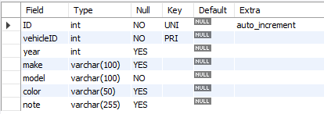
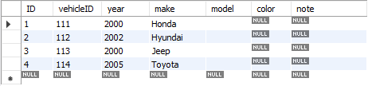
add column
CREATE TABLE vehicles (
vehicleID INT PRIMARY KEY ,
year INT,
make VARCHAR(100)
);
ALTER TABLE vehicles
ADD ID INT UNIQUE auto_increment first,
ADD model VARCHAR(100) not null,
ADD color VARCHAR(50),
ADD note VARCHAR(255);
INSERT INTO vehicles VALUES (111, 2000, 'Honda');
INSERT INTO vehicles VALUES (112, 2002, 'Hyundai');
INSERT INTO vehicles VALUES (113, 2000, 'Jeep');
INSERT INTO vehicles VALUES (114, 2005, 'Toyota');

Slide 211
modify column
ALTER TABLE tbl_name [alter_specification [, alter_specification] ...]
alter_specification
MODIFY [COLUMN] col_name column_definition [FIRST | AFTER col_name]

Slide 212
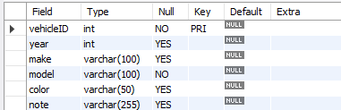
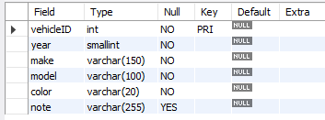
modify column
CREATE TABLE vehicles (
vehicleID INT PRIMARY KEY ,
year INT,
make VARCHAR(100),
model VARCHAR(100) not null,
color VARCHAR(50),
note VARCHAR(255)
);
ALTER TABLE vehicles
MODIFY year SMALLINT not null,
MODIFY make VARCHAR(150) not null,
MODIFY color VARCHAR(20) not null;
INSERT INTO vehicles VALUES (111, 2000, 'Honda', 'A1', 'silver', ' Honda was the first Japanese automobile manufacturer to release a dedicated luxury brand, Acura, in 1986.');
INSERT INTO vehicles VALUES (112, 2002, 'Hyundai', 'AC1', 'white', ' Hyundai operates the world's largest integrated automobile manufacturing facility in Ulsan, South Korea which has an annual production capacity of 1.6 million units.');
INSERT INTO vehicles VALUES (113, 2000, 'Jeep', 'D2', 'black', ' Fiat Chrysler Automobiles has owned Jeep since 2014. Previous owners include the Kaiser Jeep Corporation and American Motors Corporation. Most Jeeps are American-made, except for a select few models. The Toledo Assembly Complex in Ohio manufactures the Jeep Wrangler.');

Slide 213
change column
ALTER TABLE tbl_name [alter_specification [, alter_specification] ...]
alter_specification
CHANGE [COLUMN] old_col_name new_col_name column_definition [ FIRST | AFTER col_name ]

Slide 214
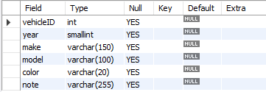
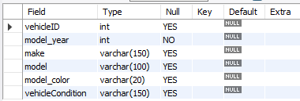
change column
CREATE TABLE vehicles (
vehicleID INT,
year SMALLINT,
make VARCHAR(150),
model VARCHAR(100),
color VARCHAR(20),
note VARCHAR(255)
);
ALTER TABLE vehicles
CHANGE year model_year INT,
CHANGE color model_color VARCHAR(20),
CHANGE note vehicleCondition VARCHAR(150);

Slide 215
change column
CREATE TABLE users (
ID INT PRIMARY KEY,
userName VARCHAR(40),
password VARCHAR(25),
email VARCHAR(255)
) ;
CREATE TABLE login (
ID INT PRIMARY KEY,
userID INT,
loginDate DATE,
loginTime TIME,
constraint fk_userID FOREIGN KEY(userID) REFERENCES users(ID)
) ;
INSERT INTO users VALUES (1, 'rajan', 'ranaj123', 'rajan447.gmail.com');
INSERT INTO users VALUES (2, 'raj', 'raj', 'raj.gmail.com');
INSERT INTO login VALUES (1, 1, curdate(), curtime());
INSERT INTO login VALUES (2, 1, curdate(), curtime());
INSERT INTO login VALUES (3, 2, curdate(), curtime());
INSERT INTO login VALUES (4, NULL, curdate(), curtime());
ALTER TABLE users CHANGE ID userID INT;
ALTER TABLE login CHANGE userID UID INT;
INSERT INTO login VALUES (5, NULL, curdate(), curtime());

Slide 216
drop column
ALTER TABLE tbl_name [alter_specification [, alter_specification] ...]
alter_specification
DROP [COLUMN] col_name

Slide 217
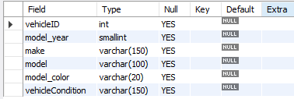

drop column
CREATE TABLE vehicles (
vehicleID INT,
model_year SMALLINT,
make VARCHAR(150),
model VARCHAR(100),
model_color VARCHAR(20),
vehicleCondition VARCHAR(150)
);
ALTER TABLE vehicles
CHANGE model_year year INT not null,
DROP model,
DROP model_color,
DROP vehicleCondition;

Slide 218
alter table
Sample table
Rename columns
CREATE TABLE vehicles (
vehicleID INT PRIMARY KEY ,
year INT,
make VARCHAR(100)
);
ALTER TABLE vehicles
CHANGE year model_year SMALLINT NOT NULL,
CHANGE color model_color VARCHAR(20),
CHANGE note vehicleCondition VARCHAR(150);
Add new columns to a table
DROP columns
ALTER TABLE vehicles
ADD model VARCHAR(100) NOT NULL,
ADD color VARCHAR(50),
ADD note VARCHAR(255);
ALTER TABLE vehicles
CHANGE model_year year INT NOT NULL,
DROP model,
DROP model_color,
DROP vehicleCondition;
Modify columns
ALTER TABLE vehicles
MODIFY year SMALLINT NOT NULL,
MODIFY color VARCHAR(20) NOT NULL,
MODIFY make VARCHAR(150) NOT NULL;

Slide 219
drop table
Remember:
DROP and TRUNCATE are DDL commands, whereas DELETE is a DML command.
DELETE operations can be rolled back (undone), while DROP and TRUNCATE operations cannot be rolled back (DDL statements are auto committed).
Dropping a TABLE also drops any TRIGGERS for the table.
Dropping a TABLE also drops any INDEX for the table.
Dropping a TABLE will not drops any VIEW for the table.
If you try to drop a PARENT/MASTER TABLE, it will not get dropped.

Slide 220
drop table
DROP [TEMPORARY] TABLE [IF EXISTS] tbl_name [, tbl_name] ...
Note:
All table data and the table definition are removed.
DROP login;
DROP TABLE users;
DROP TABLE login, users;

Slide 221
create temporary table
Note:
it is possible to create, alter, drop, and write (Insert, Update, and Delete rows) to TEMPORARY tables.

Slide 222
temporary table
Remember:
You can use the TEMPORARY keyword when creating a table.
A TEMPORARY table is visible only to the current session, and is dropped automatically when the session is closed.
Use TEMPORARY table with the same name as the original can be useful when you want to try some statements that modify the contents of the table, without changing the original table.
The permanent (original) table becomes hidden (inaccessible) to the client who creates the TEMPORARY table with same name as the original.
If you issue a DROP TABLE statement, the TEMPORARY table is removed and the original table reappears, it is possible, only when then original tbl_name and temporary tbl_name are same.
The original table also reappears if you rename the TEMPORARY table.
e.g. ALTER TABLE dept RENAME TO d;
Temporary table_name

Slide 223
temporary table
e.g.
CREATE TEMPORARY TABLE student (
ID INT PRIMARY KEY,
namefirst VARCHAR(45),
namelast VARCHAR(45),
DOB DATE,
emailID VARCHAR(128)
);
CREATE TEMPORARY TABLE temp (
ID INT PRIMARY KEY,
firstName VARCHAR(45),
phone INT,
city VARCHAR(10) DEFAULT 'PUNE',
salary INT,
comm INT,
total INT GENERATED ALWAYS AS(salary + comm) VIRTUAL
);

Slide 224
create temporary table ... like
Use CREATE TABLE ... LIKE to create an empty table based on the definition of another table.
CREATE TEMPORARY TABLE [IF NOT EXISTS] new_tbl LIKE orig_tbl;
CREATE TEMPORARY TABLE tempEmployee LIKE employee;
Remember:
LIKE works only for base tables, not for VIEWS.
You can use the TEMPORARY keyword when creating a table. A TEMPORARY table is visible only to the current session, and is dropped automatically when the session is closed.
Use TEMPORARY table with the same name as the original can be useful when you want to try some statements that modify the contents of the table, without changing the original table.
CREATE TEMPORARY TABLE new_tbl SELECT * FROM orig_tbl LIMIT 0;

Slide 225
Do not use the * operator in your SELECT statements. Instead, use column names. Reason is that in MySQL Server scans for all column names and replaces the * with all the column names of the table(s) in the SELECT statement. Providing column names avoids this search-and-replace, and enhances performance.
continue with SELECT statement…
SELECT what_to_select
FROM which_table
WHERE conditions_to_satisfy;

Slide 226
SELECT CLAUSE
The SELECT statement retrieves or extracts data from tables in the database.
You can use one or more tables separated by comma to extract data.
You can fetch one or more fields/columns in a single SELECT command.
You can specify star (*) in place of fields. In this case, SELECT will return all the fields.
SELECT can also be used to retrieve rows computed without reference to any table e.g. SELECT 1 + 2;

Slide 227
Capabilities of SELECT Statement
SELECTION
PROJECTION
JOINING

Slide 228
Capabilities of SELECT Statement
SELECTION
Selection capability in SQL is to choose the rows in a table that you want to return by a query.
R
EMPNO | ENAME | JOB | HIREDATE | DEPTNO
1 | Saleel | Manager | 1995-01-01 | 10
2 | Janhavi | Sales | 1994-12-20 | 20
3 | Snehal | Manager | 1997-05-21 | 10
4 | Rahul | Account | 1997-07-30 | 10
5 | Ketan | Sales | 1994-01-01 | 30

Slide 229
Capabilities of SELECT Statement
PROJECTION
Projection capability in SQL to choose the columns in a table that you want to return by your query.
R
EMPNO | ENAME | JOB | HIREDATE | DEPTNO
1 | Saleel | Manager | 1995-01-01 | 10
2 | Janhavi | Sales | 1994-12-20 | 20
3 | Snehal | Manager | 1997-05-21 | 10
4 | Rahul | Account | 1997-07-30 | 10
5 | Ketan | Sales | 1994-01-01 | 30

Slide 230
Capabilities of SELECT Statement
JOINING
Join capability in SQL to bring together data that is stored in different tables by creating a link between them.
R
S
EMPNO | ENAME | JOB | HIREDATE | DEPTNO
1 | Saleel | Manager | 1995-01-01 | 20
2 | Janhavi | Sales | 1994-12-20 | 10
3 | Snehal | Manager | 1997-05-21 | 10
4 | Rahul | Account | 1997-07-30 | 20
5 | Ketan | Sales | 1994-01-01 | 30
DEPTNO | DNAME | LOC
10 | HRD | PUNE
20 | SALES | BARODA
40 | PURCHASE | SURAT

Slide 232
select statement
SELECTION Process
SELECT * FROM <table_references>
selection-list | field-list | column-list
Remember:
Here, " * " is known as metacharacter (all columns)
PROJECTION Process
SELECT column-list FROM <table_references>
selection-list | field-list | column-list
Remember:
Position of columns in SELECT statement will determine the position of columns in the output (as per
user requirements)

Slide 233
SELECT 'HELLO' ' WORLD';
SELECT 'HELLO' AS 'WORLD';
SELECT ename `EmployeeName` FROM emp;
SELECT ename AS `EmployeeName` FROM emp;
column - alias
A programmer can use an alias to temporarily assign another name to a column or table for the duration of a SELECT query.
In the selection-list, a quoted column alias can be specified using identifier ( ` ) or string quote ( ' or " ) characters.
Note:
Assigning an alias_name does not actually rename the column or table.
You cannot use alias in an expression.

Slide 234
select statement - alias
SELECT A₁ [ [AS] alias_name], A₂ [ [AS] alias_name], . . ., A_{N} FROM r [ [AS] alias_name]
Remember:
A select_expr can be given an alias using AS alias_name. The alias is used as the expression's column name and can be used in GROUP BY, HAVING, or ORDER BY clauses.
The AS keyword is optional when aliasing a select_expr with an identifier.
Standard SQL disallows references to column aliases in a WHERE clause.
A table reference can be aliased using tbl_name alias_name or tbl_name AS alias_name
If the column alias contains spaces, put it in quotes.
Alias name is max 256 characters.
SELECT empno AS EmployeeID, ename EmployeeName FROM emp;
SELECT ID AS 'Employee ID', ename "Employee Name" FROM emp;
SELECT * FROM emp employee;

Slide 235
comparison functions and operator
Comparison operations result in a value of 1 (TRUE), 0 (FALSE), or NULL.
assignment _operator
= (assignment), :=
The value on the right hand side may be a literal value, another variable storing a value, or any legal expression that yields a scalar value, including the result of a query (provided that this value is a scalar value). You can perform multiple assignments in the same SET statement. You can perform multiple assignments in the same statement.
Unlike =, the := operator is never interpreted as a comparison operator. This means you can use := in any valid SQL statement (not just in SET statements) to assign a value to a variable.

Slide 236
comparison functions and operator
arithmetic_operators:
* | / | DIV | % |MOD | - | +
comparison_operator:
= | <=> | >= | > | <= | < | <> | !=
boolean_ predicate:
IS [NOT] NULL
| expr <=> null
predicate:
expr [NOT] LIKE expr [ESCAPE char]
| expr [NOT] IN (expr1, expr2, . . . )
| expr [NOT] IN (subquery)
| expr [NOT] BETWEEN expr1 AND expr2
logical_operators
{ AND | && } | { OR | || }
assignment _operator
= (assignment), :=
operand meaning: the quantity on which an operation is to be done.
e.g.
operand1 * operand2
operand1 = operand2
operand IS [NOT] NULL
operand [NOT] LIKE 'pattern'
expr AND expr
Operand := 1001
SELECT 23 DIV 6 ; #3
SELECT 23 / 6 ; #3 .8333
Note:
AND has higher precedence than OR.

Slide 237
WHERE col * 4 < 16
WHERE col < 16 / 4
SELECT CONCAT(1, "saleel");
column - expressions
"Strings are automatically converted to numbers and numbers to strings as necessary." This means that in order to compare a string to a number, it tries to parse a number from the start of the string. In this case there is no number there, so it converts to 0, and 0 = 0 is true.

Slide 238
select statement - expressions
Column EXPRESSIONS
SELECT A₁, A₂, A₃, A₄, expressions, . . . FROM r
SELECT 1001 + 1;
SELECT 1001 + '1';
SELECT '1' + '1' ;
SELECT '1' + 'a1';
SELECT '1' + '1a';
SELECT 'a1' + 1;
SELECT '1a' + 1;
SELECT 1 + -1;
SELECT 1 + -2;
SELECT -1 + -1;
SELECT -1 - 1;
SELECT -1 - -1;
SELECT 123 * 1;
SELECT -123 * 1;
SELECT 123 * -1 ;
SELECT -123 * -1;
SELECT 2 * 0;
SELECT 2435 / 1;
SELECT 2 / 0;
SELECT '2435Saleel' / 1;
SELECT sal, sal + 1000 AS 'New Salary' FROM emp;
SELECT sal, comm, sal + comm FROM emp;
SELECT sal, comm, sal + IFNULL(comm, 0) FROM emp;
SELECT ename, ename = ename FROM emp;
SELECT ename, ename = 'smith' FROM emp;
SELECT c1, c1 / 1 R1 FROM numberString;
Note:
If any expression evaluated with NULL, returns NULL.
SELECT 2 + NULL ;
SELECT 2 - NULL ;
SELECT 2 * NULL ;
SELECT 2 / NULL ;

Slide 239
identifiers
Certain objects within MySQL, including database, table, index, column, alias, view, stored procedure, stored functions, triggers, partition, tablespace, and other object names are known as identifiers.

Slide 240
identifiers
The maximum length for each type of identifiers like (Database, Table, Column, Index, Constraint, View, Stored Program, User-Defined Variable, Tablespace) is 64 characters, whereas for Alias is 256 characters.
You can refer to a table within the default database as
tbl_name
db_name.tbl_name.
You can refer to a column as
col_name
tbl_name.col_name
db_name.tbl_name.col_name.
Note:
You need not specify a tbl_name or db_name.tbl_name prefix for a column reference unless the reference would be ambiguous.
The identifier quote character is the backtick (`)

Slide 241
NULL value does not occupy space in memory.
NULL value is independent of data type.
NULL can be written in any lettercase.
null-to-null comparisons

Slide 242
the null value
The NULL value is special. It means "NO VALUE" or "UNKNOWN VALUE".
Remember:
You cannot be compared two "UNKNOWN VALUE" the way you compere two "KNOWN VALUE" to each other.
If you attempt to use NULL with the usual arithmetic comparison operators, the result is NULL (undefined).
Instead of using =, <>, or != to test for equality or inequality with NULL values, use IS NULL or IS NOT NULL
MySQL specific <=> comparison operator is used for NULL-to-NULL comparisons.

Slide 243
DATEDIFF(CURDATE(), hiredate) / 365.25
datetime functions

Slide 244
sysdate(), now(), curdate(), curtime()
In MySQL, the NOW() function returns a default value for a DATETIME.
MySQL inserts the current date and time into the column whose default value is NOW().
In MySQL, the CURDATE() returns the current date in 'YYYY-MM-DD'. CURRENT_DATE() and CURRENT_DATE are the synonym of CURDATE().
In MySQL, the CURTIME() returns the value of current time in 'HH:MM:SS'. CURRENT_TIME() and CURRENT_TIME are the synonym of CURTIME().

Slide 245
sysdate(), now(), curdate(), curtime()
NOW() returns a constant time that indicates the time at which the statement began to execute. (Within a stored function or trigger, NOW() returns the time at which the function or triggering statement began to execute.) This differs from the behavior for SYSDATE(), which returns the exact time at which it executes.
SELECT SYSDATE()
SELECT NOW()
SELECT CURDATE()
SELECT CURTIME()
Result in something like this:
SYSDATE() NOW() CURDATE() CURTIME()
2017-02-11 10:22:31 2017-02-11 10:22:31 2017-02-11 10:22:31
mysql> SELECT NOW(), SLEEP(7), NOW();
mysql> SELECT SYSDATE(), SLEEP(7), SYSDATE();

Slide 246
+ or - operator
Date arithmetic also can be performed using INTERVAL together with the + or - operator
date + INTERVAL expr unit + INTERVAL expr unit + INTERVAL expr unit + . . .
date - INTERVAL expr unit - INTERVAL expr unit - INTERVAL expr unit - . . .
SELECT NOW(), NOW() + INTERVAL 1 DAY;
SELECT NOW(), NOW() + INTERVAL '1-3' YEAR_MONTH;
unit Value | expr | unit Value | expr
SECOND | SECONDS | DAY_HOUR | 'DAYS HOURS' e.g. '1 1'
MINUTE | MINUTES | DAY_MINUTE | 'DAYS HOURS:MINUTES' e.g. '1 3:34'
HOUR | HOURS | DAY_SECOND | 'DAYS HOURS:MINUTES:SECONDS'
DAY | DAYS | HOUR_MINUTE | 'HOURS:MINUTES' e.g. '3:34'
WEEK | WEEKS | HOUR_SECOND | 'HOURS:MINUTES:SECONDS'
MONTH | MONTHS | MINUTE_SECOND | 'MINUTES:SECONDS' e.g. '27:34'
QUARTER | QUARTERS | YEAR_MONTH | 'YEARS-MONTHS' e.g. '1-3'
YEAR | YEARS

Slide 247
extract
The EXTRACT() function is used to return a single part of a date/time, such as year, month, day, hour, minute, etc.
EXTRACT(unit FROM date)
Unit Value
MICROSECOND | SECOND | MINUTE | HOUR | DAY
WEEK | MONTH | QUARTER | YEAR
MINUTE_SECOND | HOUR_SECOND | DAY_SECOND | DAY_HOUR
HOUR_MINUTE | DAY_MINUTE | YEAR_MONTH
SELECT EXTRACT(MONTH FROM NOW());
SELECT EXTRACT(YEAR_MONTH FROM NOW()) ;
Note:
There must no space between extract function and ().
e.g.
SELECT EXTRACT (MONTH FROM NOW()); # error

Slide 248
datetime functions
Syntax | Result
DAY(date) | DAY() is a synonym for DAYOFMONTH().
DAYNAME(date) | Returns the name of the weekday for date.
DAYOFMONTH(date) | Returns the day of the month for date, in the range 1 to 31
DAYOFWEEK(date) | Returns the weekday index for date (1 = Sunday, 2 = Monday, …, 7 = Saturday).
DAYOFYEAR(date) | Returns the day of the year for date, in the range 1 to 366
LAST_DAY(date) | Takes a date or datetime value and returns the corresponding value for the last day of the month. Returns NULL if the argument is invalid.
MONTH(date) | Returns the month for date, in the range 1 to 12 for January to December
MONTHNAME(date) | Returns the full name of the month for date.
YEAR(date) | Returns the year in 4 digit

Slide 249
datetime functions
Syntax | Result
WEEKDAY(date) | Returns the weekday index for date (0 = Monday, 1 = Tuesday, … 6 = Sunday).
WEEKOFYEAR(date) | Returns the calendar week of the date as a number in the range from 1 to 53.
QUARTER(date) | Returns the quarter of the year for date, in the range 1 to 4.
HOUR(time) | Returns the hour for time. The range of the return value is 0 to 23 for time-of-day values.
MINUTE(time) | Returns the minute for time, in the range 0 to 59.
SECOND(time) | Returns the second for time, in the range 0 to 59.
DATEDIFF(expr1, expr2) | Returns the number of days between two dates or datetimes.
STR_TO_DATE(str, format) | Convert a string to a date.

Slide 250
datetime formats

Slide 251
datetime formats
Formats | Description
%a | Abbreviated weekday name (Sun-Sat)
%b | Abbreviated month name (Jan-Dec)
%c | Month, numeric (1-12)
%D | Day of month with English suffix (0th, 1st, 2nd, 3rd, �)
%d | Day of month, numeric (01-31)
%e | Day of month, numeric (1-31)
%f | Microseconds (000000-999999)
%H | Hour (00-23)
%h | Hour (01-12)
SELECT DATE_FORMAT(NOW(), '%a');

Slide 252
datetime formats
Formats | Description
%I | Hour (01-12)
%i | Minutes, numeric (00-59)
%j | Day of year (001-366)
%k | Hour (0-23)
%l | Hour (1-12)
%M | Month name (January-December)
%m | Month, numeric (01-12)
%p | AM or PM
%r | Time, 12-hour (hh:mm:ss followed by AM or PM)
%S | Seconds (00-59)
%s | Seconds (00-59)
SELECT DATE_FORMAT(NOW(), '%j');

Slide 253
datetime formats
Formats | Description
%T | Time, 24-hour (hh:mm:ss)
%U | Week (00-53) where Sunday is the first day of week
%u | Week (00-53) where Monday is the first day of week
%V | Week (01-53) where Sunday is the first day of week, used with %X
%v | Week (01-53) where Monday is the first day of week, used with %x
%W | Weekday name (Sunday-Saturday)
%w | Day of the week (0=Sunday, 6=Saturday)
%X | Year for the week where Sunday is the first day of week, four digits, used with %V
%x | Year for the week where Monday is the first day of week, four digits, used with %v
%Y | Year, numeric, four digits
%y | Year, numeric, two digits
SELECT DATE_FORMAT(NOW(), '%Y');

Slide 254
string functions

Slide 255
string functions
Syntax | Result
ASCII(str) | Returns the numeric value of the leftmost character of the string str. Returns 0 if str is the empty string. Returns NULL if str is NULL. e.g. SELECT ASCII(ename) FROM emp;
CHAR(N, , . . .) | CHAR() interprets each argument N as an integer and returns a string consisting of the characters given by the code values of those integers. NULL values are skipped. e.g. SELECT CHAR(65, 66, 67); / SELECT CAST(CHAR(65 66, 67) AS CHAR);
CONCAT(str1, str2, . . .) | Returns the string that results from concatenating the arguments. CONCAT() returns NULL if any argument is NULL. e.g. SELECT CONCAT('Mr. ' , ename) FROM emp; SELECT CONCAT('My', NULL, 'SQL’); #op will be NULL
ELT(N, str1, str2, str3, . . .) | ELT() returns the Nth element of the list of strings: str1 if N = 1, str2 if N = 2, and so on. Returns NULL if N is less than 1 or greater than the number of arguments. e.g. SELECT ELT(1, 'Bank', 'Of', 'India', 'Kothrud', 'Pune'); SELECT ELT(1, ename, job, sal) FROM emp;

Slide 256
string functions
Syntax | Result
STRCMP(expr1, expr2) | STRCMP() returns 0 if the strings are the same, -1 if the first argument is smaller than the second according to the current sort order, and 1 otherwise.
LCASE(str) | Returns lower case string. LCASE() is a synonym for LOWER().
UCASE(str) | Returns upper case string. UCASE() is a synonym for UPPER().
LENGTH(str) | Returns the length of the string.
LPAD(str, len, padstr) | Returns the string str, left-padded with the string padstr to a length of len characters.
RPAD(str, len, padstr) | Returns the string str, right-padded with the string padstr to a length of len characters.
REPEAT(str, count) | Returns a string consisting of the string str repeated count times. If count is less than 1, returns an empty string. Returns NULL if str or count are NULL.

Slide 257
string functions
Syntax | Result
LEFT(str, len) | Returns the leftmost len characters from the string str, or NULL if any argument is NULL.
RIGHT(str, len) | Returns the rightmost len characters from the string str, or NULL if any argument is NULL.
LTRIM(str) | Returns the string str with leading space characters removed.
RTRIM(str) | Returns the string str with trailing space characters removed.
TRIM(str) | Returns the string str with leading and trailing space characters removed.
BINARY value | Convert a value to a binary string.
SELECT ename, BINARY ename FROM emp;

Slide 258
string functions
Syntax | Result
INSTR(str, substr) | Returns the position of the first occurrence of substring substr in string str.
REPLACE(str, from_str, to_str) | Returns the string str with all occurrences of the string from_str replaced by the string to_str. REPLACE() performs a case-sensitive match when searching for from_str. e.g. SELECT REPLACE('Hello', 'l', 'x');
REVERSE(str) | Returns the string str with the order of the characters reversed.
SUBSTR(str, pos, len) | SUBSTR() is a synonym for SUBSTRING(). e.g. SELECT SUBSTR ('This is the test by IWAY', 6); SELECT SUBSTR ('This is the test by IWAY', -4, 4);
MID(str, pos, len) | MID function is a synonym for SUBSTRING.

Slide 259
mathematical functions

Slide 260
mathematical functions
Syntax | Result
ABS(x) | Returns the absolute value of X.
CEIL(x) | CEIL() is a synonym for CEILING().
CEILING(x) | Returns CEIL value.
FLOOR(x) | Returns FLOOR value.
MOD(n, m), n % m, n MOD m | Returns the remainder of N divided by M. MOD(N,0) returns NULL.
POWER(x, y) | This is a synonym for POW().
RAND() | Returns a random floating-point value
ROUND(x) ROUND(x, d) | Rounds the argument X to D decimal places. The rounding algorithm depends on the data type of X. D defaults to 0 if not specified. D can be negative to cause D digits left of the decimal point of the value X to become zero.
TRUNCATE(x, d) | Returns the number X, truncated to D decimal places. If D is 0, the result has no decimal point or fractional part. D can be negative to cause D digits left of the decimal point of the value X to become zero.

Slide 261
Note:
TABLE statement always displays all columns of the table.
TABLE statement does not support any WHERE clause.
TABLE statement can be used with temporary tables.
table statement…
TABLE is a DML statement introduced in MySQL 8.0.19 which returns rows and columns of the named table.

Slide 262
table statement
The TABLE statement in some ways acts like SELECT. You can order and limit the number of rows produced by TABLE using ORDER BY and LIMIT clauses, respectively.
TABLE tbl_name [ORDER BY col_name] [LIMIT number [OFFSET number]]
TABLE emp;
TABLE emp ORDER BY 2;
TABLE emp ORDER BY 2 LIMIT 1, 2;
TABLE t1 UNION TABLE t2;

Slide 263

Remember:
Here, "*" is known as metacharacter (all columns)
select statement… syntax
SELECT is used to retrieve rows selected from one or more tables (using JOINS), and can include UNION statements and SUBQUERIES.

Slide 264
syntax
select statement
modifiers
SELECT [ALL / DISTINCT / DISTINCTROW] identifier.* / identifier.A₁ [ [as] alias_name], identifier.A₂ [ [as] alias_name], identifier.A₃ [ [as] alias_name], expression1 [ [as] alias_name], expression2 [ [as] alias_name] . . .
[ FROM <identifier.r₁> [as] alias_name], <identifier.r₂> [as] alias_name], . . . ]
[ WHERE < where_condition1 > { and | or } < where_condition2 > . . . ]
[ GROUP BY < { col_name | expr | position }, . . . [ WITH ROLLUP ] > ]
[ HAVING < having_condition1 > { and | or } < having_condition2 > . . . ]
[ ORDER BY < { col_name | expr | position } [ ASC | DESC ], . . . > ]
[ LIMIT < { [offset,] row_count | row_count OFFSET offset } > ]
[ FOR { UPDATE } ]
[ { INTO OUTFILE 'file_name' | INTO DUMPFILE 'file_name' | INTO var_name [, var_name], . . . } ]

Slide 265
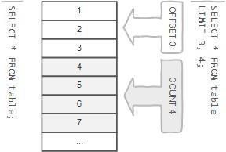
row limiting clause
LIMIT is applied after HAVING
Remember:
LIMIT enables you to pull a section of rows from the middle of a result set. Specify two values: The number of rows to skip at the beginning of the result set, and the number of rows to return.
Note:
Limit value are not to be given within ( . . . )
Limit takes one or two numeric arguments, which must both be non-negative integer value.

Slide 266
Nulls by default occur at the top, but you can use IsNull to assign default values, that will put it in the position you require. . The ISNULL() function tests whether an expression is NULL. If expression is a NULL value, the ISNULL() function returns 1. Otherwise, it returns 0.
SELECT id AS 'a' FROM tbl_name ORDER BY `a`;
SELECT id AS 'a' FROM tbl_name ORDER BY 'a';
order by clause
To sort a result, use an ORDER BY clause.
Remember:
The default sort order is ascending ASC, with smallest values first. To sort in descending (reverse) order, add the DESC keyword to the name of the column you are sorting by.
You can sort on multiple columns, and you can sort different columns in different directions.
If the ASC or DESC modifier is not provided in the ORDER BY clause, the results will be sorted by expression in ASC (ascending) order. This is equivalent to ORDER BY expression ASC.

Slide 267
Remember:
In WHERE clause operations can be performed using…
CONSTANTS
TABLE columns
FUNCTION calls (PRE-DEFINED / UDF)
In SQL, a logical expression is often called a predicate.
where clause
The WHERE Clause is used when you want to retrieve specific information from a table excluding other irrelevant data.
Note:
Expressions in WHERE clause can use.
Arithmetic operators
Comparison operators
Logical operators
Note:
All comparisons return FALSE when either argument is NULL, so no rows are ever selected.

Slide 268
SELECT * FROM emp WHERE comm IS UNKNOWN;
SELECT * FROM emp WHERE comm IS NOT UNKNOWN;
operand IS [NOT] NULL
boolean_ predicate:
IS [NOT] NULL
| expr <=> null
is null / is not null
"IS NULL" is the keyword that performs the Boolean comparison. It returns true if the supplied value is NULL and false if the supplied value is not NULL.
“IS NOT NULL" is the keyword that performs the Boolean comparison. It returns true if the supplied value is not NULL and false if the supplied value is null.
Note:
IS UNKNOWN is synonym of IS NULL.
IS NOT UNKNOWN is synonym of IS NOT NULL.

Slide 269
READ
FROM
WHERE
SELECT
identifier.state IN ('VT', 'NH', . . .)
output
states
identifier.*
predicate:
expr [NOT] IN (expr1, expr2, . . . )
| expr [NOT] IN (subquery)
in
The IN statement is used in a WHERE clause to choose items from a set. The IN operator allows you to determine if a specified value matches any value in a set of values or value returned by a subquery.
SELECT . . . FROM r₁ WHERE (
state = 'VT' OR
state = 'NH' OR
state = 'ME' OR
state = 'MA' OR
state = 'CT' OR
state = 'RI'
);
SELECT . . . FROM r₁ WHERE state IN ('VT', 'NH', 'ME', 'MA', 'CT', 'RI');
SELECT . . . FROM r₁ WHERE state IN (SELECT . . . );
A IN (B1, B2, B3, etc.) | A is found in the list (B1, B2, etc.)

Slide 270
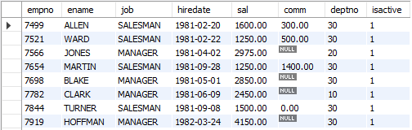
in
syntax
column | expression IN ( v1, v2, v3, . . . )
column | expression IN (subquery)
Remember:
If a value in the column or the expression is equal to any value in the list, the result of the IN operator is TRUE.
The IN operator is equivalent to multiple OR operators.
To negate the IN operator, you use the NOT IN operator.
SELECT empno, ename, job, hiredate, sal, comm, deptno, isactive FROM emp WHERE job IN ('salesman', 'manager');

Slide 271
READ
FROM
WHERE
SELECT
output
emp
identifier.sal BETWEEN
1000 and 3000
identifier.*
predicate:
expr [NOT] BETWEEN expr1 AND expr2
between
The BETWEEN operator is a logical operator that allows you to specify a range to test.
A BETWEEN B AND C | A is between B and C

Slide 272
between
syntax
WHERE salary BETWEEN ( 20000 AND 30000 ) – Illegal
column | expression BETWEEN start_expression AND end_expression
Remember:
The BETWEEN operator returns TRUE if the expression to test is greater than or equal to the value of the start_expression and less than or equal to the value of the end_expression.
You can use the greater than or equal to (>=) and less than or equal to (<=) to substitute the BETWEEN operator.
Note:
if any input to the BETWEEN or NOT BETWEEN is NULL, then the result is UNKNOWN.
e.g.
SELET empno, ename, job, hiredate, sal, comm, deptno, isactive FROM emp WHERE sal BETWEEN 1000 AND NULL;
SELECT * FROM salespeople WHERE FORMAT(comm, 2) > 0.1 AND FORMAT(comm, 2) < 0.26;

Slide 273
READ
FROM
WHERE
SELECT
output
identifier.ename LIKE 'a%'
identifier.*
emp
predicate:
expr [NOT] LIKE expr [ESCAPE char]
like
The LIKE operator is a logical operator that tests whether a string contains a specified pattern or not.

Slide 274
like - string comparison functions
syntax
column | expression LIKE 'pattern' [ESCAPE escape_character]
Remember:
% matches any number of characters, even zero characters.
_ matches exactly one character.
If we use default escape character '\', then don’t use ESCAPE keyword.
Note:
The ESCAPE keyword is used to escape pattern matching characters such as the (%) percentage and underscore (_) if they form part of the data.
If you do not specify the ESCAPE character, \ is assumed.

Slide 275
READ
FROM
GROUP BY
SELECT
output
identifier.job
AVG(sal), SUM(sal), MAX(sal), MIN(sal), COUNT(*)
emp
aggregate functions
SUM, AVG, MAX, MIN, COUNT, and GROUP_CONCAT
SELECT . . . . . FROM table_name WHERE <condition> / GROUP BY column_name
this is invalid
SET SQL_MODE = ' ';
SET SQL_MODE = IGNORE_SPACE;
SUM(colNM) / AVG(colNM) / MAX(colNM)
MIN(colNM) / COUNT(*) / COUNT(colNM)
Remember:
None of the below two queries get executed successfully. The reason is that a condition in a WHERE clause cannot contain any aggregate function (or group function) without a subquery!
SELECT empno, ename, sal, deptno FROM emp WHERE sal = MAX(sal); #error
SELECT empno, ename, sal, deptno FROM emp WHERE MAX(sal) = sal; #error

Slide 276
aggregate functions
Remember:
There are 3 places where aggregate functions can appear in a query.
in the SELECT-LIST/FIELD-LIST (the items before the FROM clause).
in the ORDER BY clause.
in the HAVING clause.
Note:
The aggregate functions allow you to perform the calculation of a set of rows and return a single value.
The WHERE clause cannot refer to aggregate functions. e.g. WHERE SUM(sal) = 5000 # Invalid, Error
The HAVING clause can refer to aggregate functions. e.g. HAVING SUM(sal) = 5000 # Valid, No Error
Nesting of aggregate functions are not allowed.
e.g.
SELECT MAX(COUNT(*)) FROM emp GROUP BY deptno;
Blank space between aggregate functions like (SUM, MIN, MAX, COUNT) are not allowed.
e.g.
SELECT SUM (sal) FROM emp;
The GROUP BY clause is often used with an aggregate function to perform calculation and return a single value for each subgroup.

Slide 277
aggregate functions
Things to… Remember:
TODO
AVG([DISTINCT] expr)
If there are no matching rows, AVG() returns NULL.
AVG() may take a numeric argument, and it returns a average of non-NULL values.
e.g.
SELECT AVG(1) "R1";
SELECT AVG(NULL) "R1";
SELECT AVG(1) "R1" WHERE True;
SELECT AVG(1) "R1" WHERE False;
SELECT AVG(1) "R1" FROM emp;
SELECT AVG(sal) "R1" FROM emp WHERE empno = -1;
SELECT AVG(sal) "Avg Salary" FROM emp;
SELECT job, AVG(sal) "Avg Salary" FROM emp GROUP BY job;

Slide 278
aggregate functions
Things to… Remember:
TODO
SUM([DISTINCT] expr)
If there are no matching rows, SUM() returns NULL.
SUM() may take a numeric argument , and it returns a sum of non-NULL values.
e.g.
SELECT SUM(1) "R1";
SELECT SUM(NULL) "R1";
SELECT SUM(2 + 2 * 2);
SELECT SUM(1) "R1" WHERE True;
SELECT SUM(1) "R1" WHERE False;
SELECT SUM(1) "R1" FROM emp;
SELECT SUM(sal) "R1" FROM emp WHERE empno = -1;
SELECT SUM(sal) "Total Salary" FROM emp;
SELECT job, SUM(sal) "Total Salary" FROM emp GROUP BY job;

Slide 279
aggregate functions
Things to… Remember:
TODO
SUM([DISTINCT] expr)
If there are no matching rows, SUM() returns NULL.
SUM() may take a numeric argument , and it returns a sum of non-NULL values.
r = { -2, 1, 2, -1, 3, -2, 1, 2, 1 }
SELECT SUM(c1) "R1" FROM r;
SELECT SUM(IF(c1 >= 0, c1, NULL)) FROM r;
SELECT SUM(IF(c1 < 0, c1, NULL)) FROM r;
SELECT custId, type, amount, CASE type WHEN 'd' THEN amount WHEN 'c' THEN amount * -1 END amount FROM transactions;

Slide 280
aggregate functions
Things to… Remember:
TODO
MAX([DISTINCT] expr)
If there are no matching rows, MAX() returns NULL.
MAX() may take a string, number, and date argument, and it returns a maximum of non-NULL values.
e.g.
SELECT MAX(1) "R1";
SELECT MAX(NULL) "R1";
SELECT MAX('VIKAS');
SELECT MAX(1) "R1" WHERE True;
SELECT MAX(1) "R1" WHERE False;
SELECT MAX(1) "R1" FROM emp;
SELECT MAX(sal) "R1" FROM emp WHERE empno = -1;
SELECT MAX(sal) "Maximum Salary" FROM emp;
SELECT job, MAX(sal) "Maximum Salary" FROM emp GROUP BY job;

Slide 281
aggregate functions
Things to… Remember:
TODO
MIN([DISTINCT] expr)
If there are no matching rows, MIN() returns NULL.
MIN() may take a string, number, and date argument, and it returns a minimum of non-NULL values.
e.g.
SELECT MIN(1) "R1";
SELECT MIN(NULL) "R1";
SELECT MIN(1) "R1" WHERE True;
SELECT MIN(1) "R1" WHERE False;
SELECT MIN(1) "R1" FROM emp;
SELECT MIN(sal) "R1" FROM emp WHERE empno = -1;
SELECT MIN(sal) "Minimum Salary" FROM emp;
SELECT job, MIN(sal) "Minimum Salary" FROM emp GROUP BY job;

Slide 282
aggregate functions
Things to… Remember:
TODO
COUNT([DISTINCT] expr)
If there are no matching rows, COUNT() returns 0.
Returns a count of the number of non-NULL values.
COUNT(*) is somewhat different in that it returns a count of the number of rows retrieved, whether or not they contain NULL values.
COUNT (*) is a special implementation of the COUNT function that returns the count of all the rows in a specified table.
COUNT (*) also considers Nulls and duplicates.
e.g.
SELECT COUNT(*) "R1";
SELECT COUNT(NULL) "R1";
SELECT COUNT(*) "R1" WHERE True;
SELECT COUNT(*) "R1" WHERE False;
SELECT COUNT(0) FROM emp;
SELECT COUNT(1) FROM emp;
SELECT COUNT(*) FROM emp WHERE empno = -1;
SELECT COUNT(comm) "R1" FROM emp;
SELECT job, COUNT(*) "R1" FROM emp GROUP BY job;
Note:
COUNT (*): Returns a number of rows in a table including duplicates rows and rows containing null values in any of the columns.
COUNT (EXP): Returns the number of non-null values in the column identified by expression.
COUNT (DISTINCT EXP): Returns the number of unique, non-null values in the column identified by expression.

Slide 283
aggregate functions
Things to… Remember:
TODO
GROUP_CONCAT([DISTINCT] expr
[ORDER BY {unsigned_integer | col_name | expr} [ASC | DESC] [,col_name . . .]]
[SEPARATOR str_val])
e.g.
SELECT job, GROUP_CONCAT(ename) FROM emp GROUP BY job;
SELECT deptno, GROUP_CONCAT(ename) FROM emp group BY deptno;
SELECT job, CONCAT(GROUP_CONCAT(ename),' (', COUNT(*), ')') FROM emp GROUP BY job;
SELECT job, CONCAT(GROUP_CONCAT(sal),' (', MAX(sal), ')') FROM emp GROUP BY job;
SELECT job, CONCAT(GROUP_CONCAT(sal),' (', SUM(sal), ')') FROM emp GROUP BY job;

Slide 284

"Live as if you were to die tomorrow.
Learn as if you were to live forever"

